Slide 1

Welcome to the interactive launch presentation…
Firstly, don’t panic! You won’t use every one of the 288 slides when you launch Unifrog using this presentation.
This PowerPoint gives a short round-up of each of the Unifrog student tools. It’s perfect for launching a selection of tools with students, or giving a mid-year reminder of the power of the platform to staff.
At the end of each section, you’ll be taken to the menu tile (see slide two), where you can select the next tool you’d like to explore. The coloured boxes on the menu tile are hyperlinked to their relative tool!

Slide 2

Exploring pathways
Recording what you’ve done
Searching for opportunities
Drafting application materials
Making applications
Careers library
Activities
UK universities
UK Personal Statement
Post 16/18 Intentions
Subjects library
Competencies
US universities
Academics
Locker
Know-how library
Interactions
European universities
CV / Resumé
Applications list
MOOC
Oxbridge
Common App Essay
Personality profile
Apprenticeships
US recommenders
Interests profile
College / Sixth Form
Notes for Ref Writers
Canadian universities
Asian universities
Australasian unis
Create an account
Special opportunities
Sign up
ME and African unis
Irish universities

Slide 3

The complete destinations platform

Slide 4
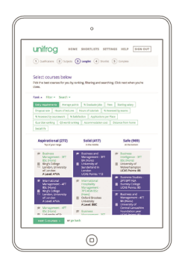
1) Exploring pathways
Use the tools in the Exploring pathways section to do some research into the options available to you after school.
Our Tools:
Careers library
Subjects library
Know-how library
MOOC
Personality profile
Interests profile

Slide 5
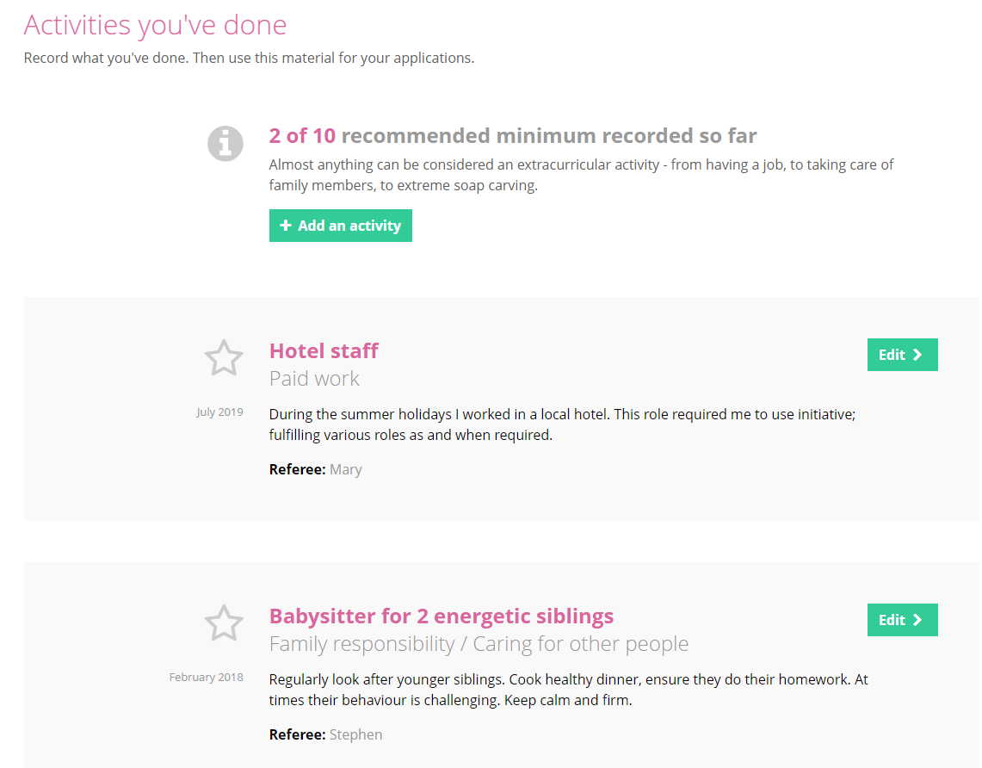
2) Recording what you have done
Use the tools in this section to get Recording what you have done, using guidance and examples and preparing yourself for making applications.
Our Tools:
Activities
Competencies
Interactions

Slide 6
3) Searching for opportunities
Use the tools in the Searching for opportunities section to compare courses, apprenticeship openings and colleges.
Our Tools:
UK universities
Canadian universities
US universities
Asian universities
European universities
Australasian unis
Oxbridge
Special opportunities
Apprenticeships
ME and African unis
College / Sixth Form
Irish universities

Slide 7
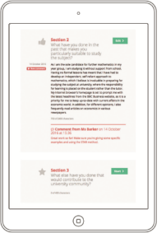
4) Drafting application materials
Use the tools in the Drafting applications section to start your application process, using guidance and examples provided.
Our Tools:
UK Personal Statement
Academics
CV / Resume
Common App Essay
US recommenders
Notes for Ref Writers

Slide 8
5) Making applications
Use the tools in the Making applications section to store important items, and then prepare applications.
Our Tools:
Post 16/18 Intentions
Locker
Applications list

Slide 9
Signing in to your Unifrog Account

Slide 10
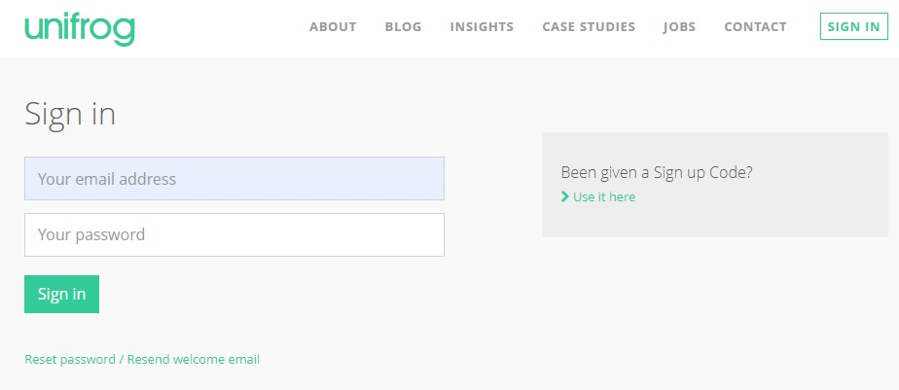
First time sign-up
When you sign in for the first time, you will use a Sign up Code which will link you with your form tutor.
Notes:
Teachers’ notes:
You can find Form Codes in the Your school section on the Teacher side of the platform.
Delete slides 10-11 if students were bulk uploaded.

Slide 11
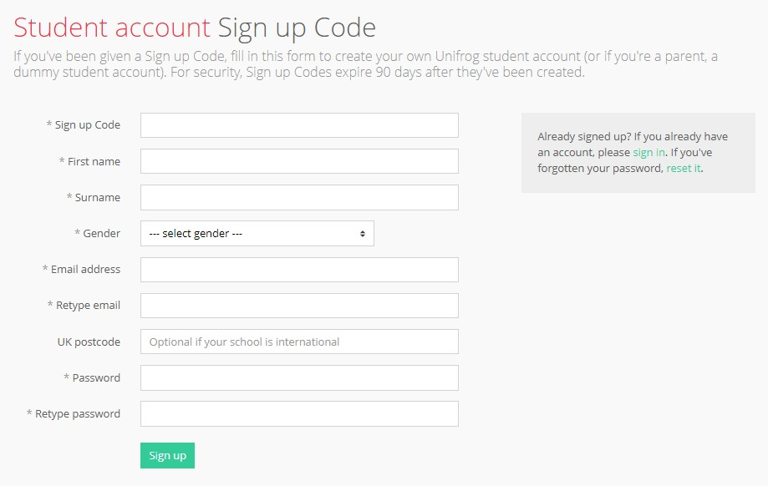
Complete the Sign up page
Completing the Sign up page is simple.
First, put your Sign up Code in.
Use an email address that you access regularly, your home postcode and create a memorable password.

Slide 12
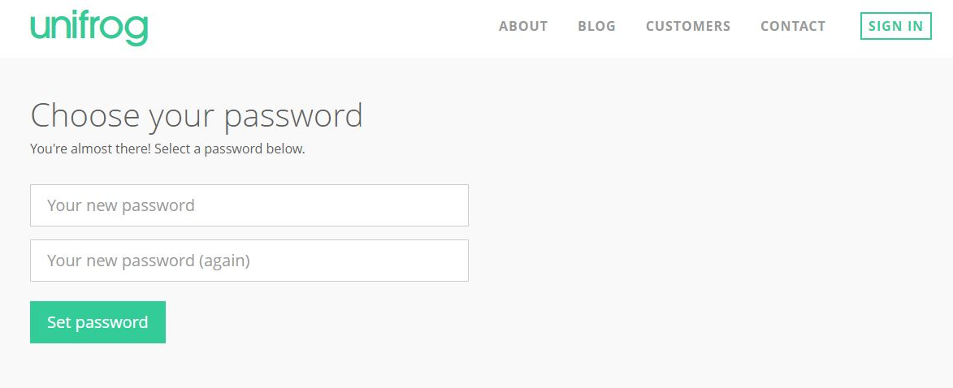
Creating your account
A link has been sent to your school email address (please check your junk/spam mailboxes).
Click the link and follow the instructions.
Create a memorable password and make a note of your password!
Notes:
Teacher’s notes:
Delete this slide (slide 12) if students were uploaded using Sign up Codes.

Slide 13
Access your accounts
Every time you login to Unifrog from now on, sign in using the button in the top right-hand corner of the homepage.
If you do forget your password, hit this link to reset.

Slide 14
Exploring pathways
Recording what you’ve done
Searching for opportunities
Drafting application materials
Making applications
Careers library
Activities
UK universities
UK Personal Statement
Post 16/18 Intentions
Subjects library
Competencies
US universities
Academics
Locker
Know-how library
Interactions
European universities
CV / Resumé
Applications list
MOOC
Oxbridge
Common App Essay
Personality profile
Apprenticeships
US recommenders
Interests profile
College / Sixth Form
Notes for Ref Writers
Canadian universities
Asian universities
Australasian unis
Create an account
Special opportunities
Sign up
ME and African unis
Irish universities

Slide 15
Exploring pathways

Slide 16
1) Exploring pathways
Use the tools in the Exploring pathways section to do some research into the options available to you after school.
Our Tools:
Careers library
Subjects library
Know-how library
MOOC
Personality profile
Interests profile

Slide 17

Using the Careers library

Slide 18


The Careers library allows you to explore different career options by providing information from a range of sources, including interviews with people working within the industry.

Slide 19
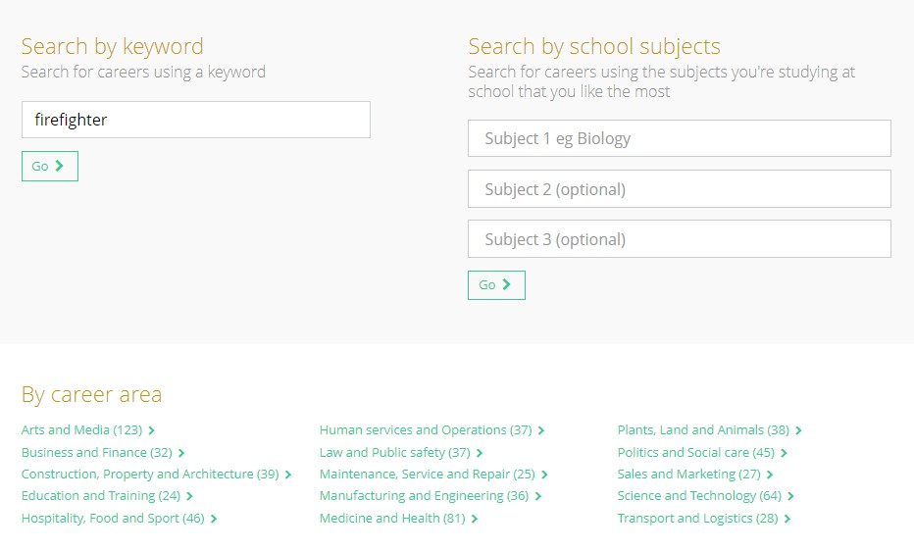
You can search by keyword, school subjects or career area…

Slide 20
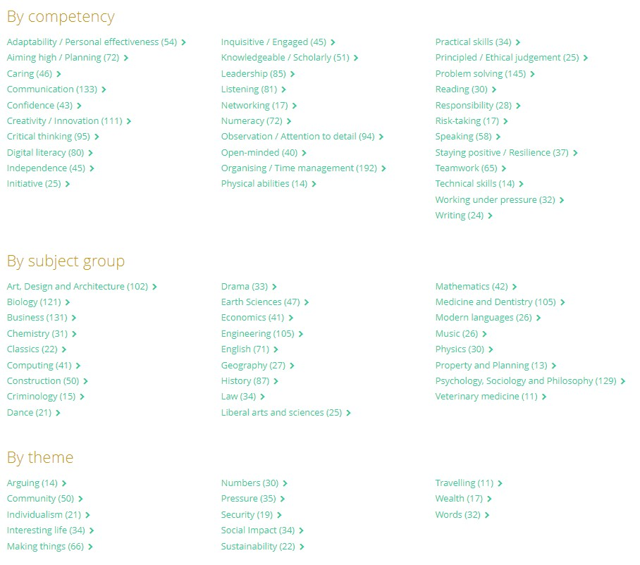
... by competency, subject group, or theme…

Slide 21
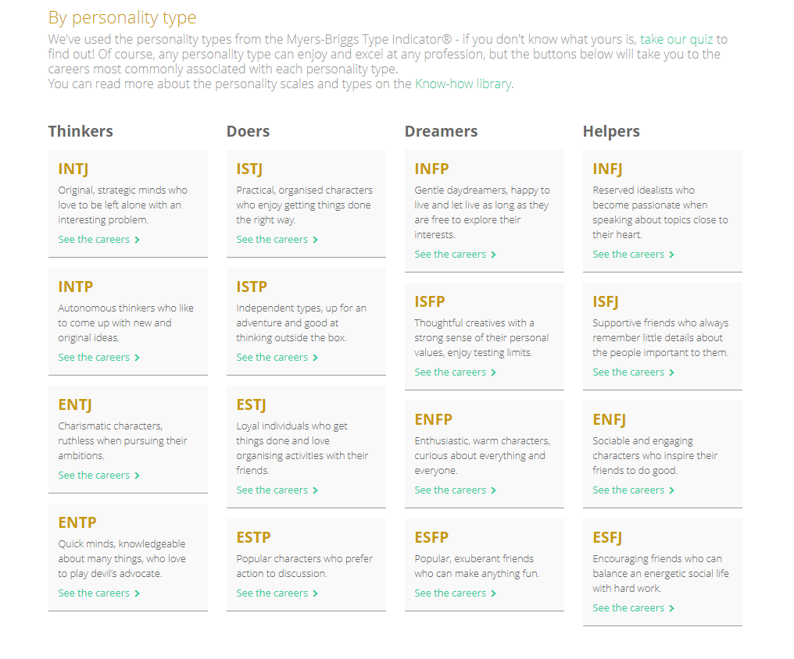
... or by personality type.

Slide 22

Once you’ve found a role that interests you, you can watch interviews from people working within that industry, and learn more about the skills required for the role.

Slide 23

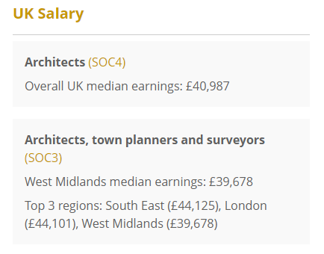
You can also learn more about entry requirements, various routes into roles, and expected salaries of specific careers.

Slide 24

Click the heart button on a career to add it to your Careers library dashboard.

Slide 25
Exploring pathways
Recording what you’ve done
Searching for opportunities
Drafting application materials
Making applications
Careers library
Activities
UK universities
UK Personal Statement
Post 16/18 Intentions
Subjects library
Competencies
US universities
Academics
Locker
Know-how library
Interactions
European universities
CV / Resumé
Applications list
MOOC
Oxbridge
Common App Essay
Personality profile
Apprenticeships
US recommenders
Interests profile
College / Sixth Form
Notes for Ref Writers
Canadian universities
Asian universities
Australasian unis
Create an account
Special opportunities
Sign up
ME and African unis
Irish universities

Slide 26

Using the Subjects library

Slide 27

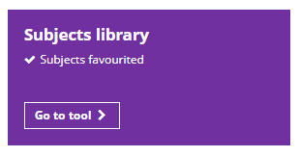
The Subjects library allows you to explore detailed profiles of every major university subject area with in-depth sections covering reading lists, podcasts to follow, films to watch, articles to read, and hot topics to think about.

Slide 28
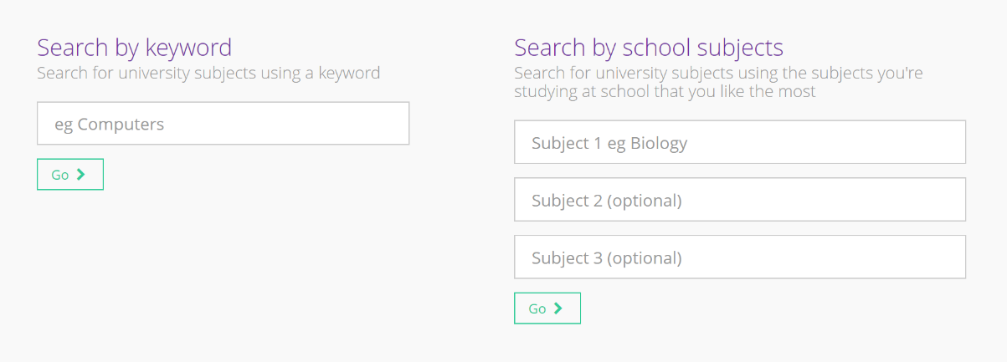
Search for courses by keyword, or try putting in the subjects you’re studying at the moment...

Slide 29
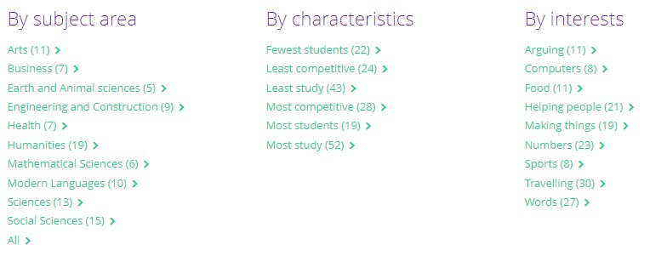
… you can also search by area, characteristics or interests.

Slide 30
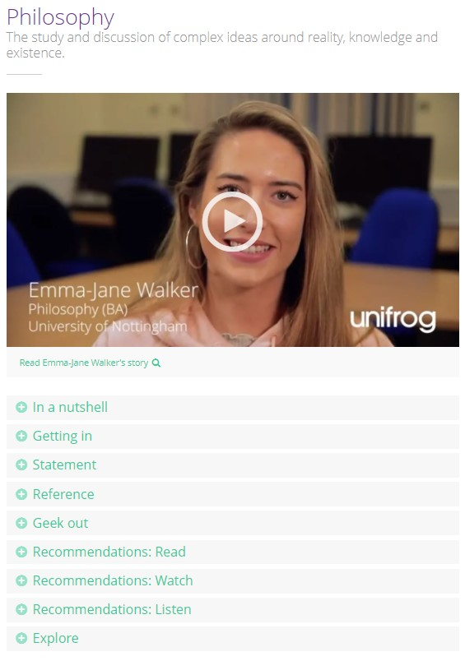
Watch interviews with university students, read up on their experience and advice, have a look at their annotated personal statement, or browse the ‘Recommendations’ sections for books, articles, podcasts, TED talks and current issues related to your subject.

Slide 31
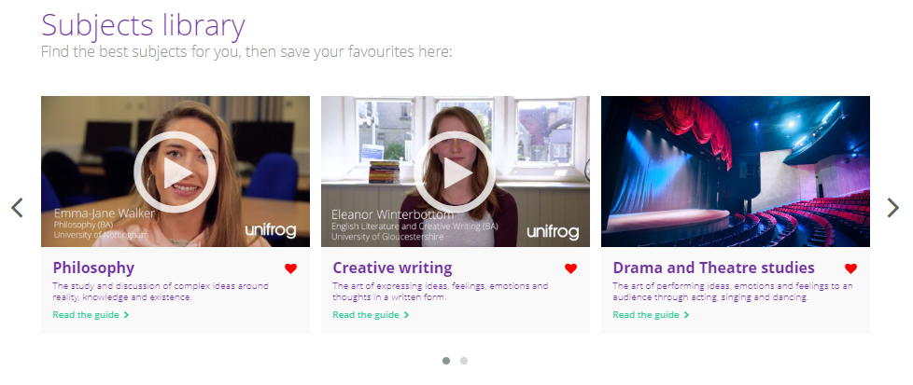
Click the heart at the bottom of each guide to favourite courses, so you can access them again easily from the top of the Subjects library homepage.

Slide 32
Exploring pathways
Recording what you’ve done
Searching for opportunities
Drafting application materials
Making applications
Careers library
Activities
UK universities
UK Personal Statement
Post 16/18 Intentions
Subjects library
Competencies
US universities
Academics
Locker
Know-how library
Interactions
European universities
CV / Resumé
Applications list
MOOC
Oxbridge
Common App Essay
Personality profile
Apprenticeships
US recommenders
Interests profile
College / Sixth Form
Notes for Ref Writers
Canadian universities
Asian universities
Australasian unis
Create an account
Special opportunities
Sign up
ME and African unis
Irish universities

Slide 33

Using the Know-how library

Slide 34


The Know-how library is filled with videos and guides to help you when you’re researching opportunities in the UK and internationally.
You’ll also find guides on citizenship and wellbeing topics too!

Slide 35
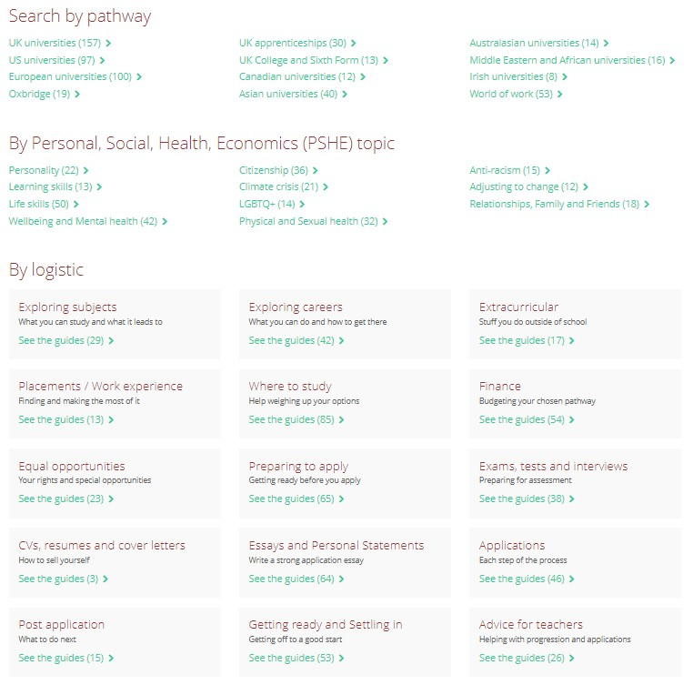
Choose a pathway, PSHE topic, or logistic you’re interested in…

Slide 36
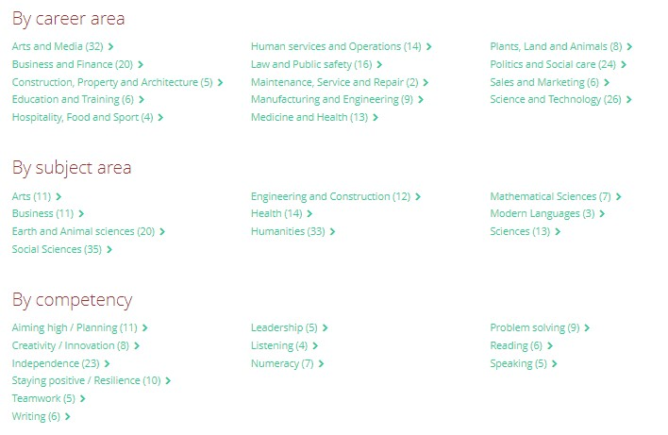
Or find a career area, subject area, or competency that you want to learn more about!

Slide 37


Within each category, you’ll find a range of videos and guides to help you make the right choice of pathway for you.

Slide 38
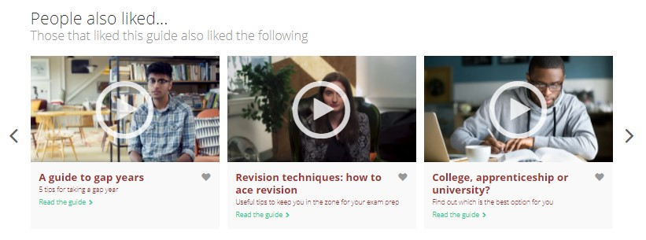
You will also be recommended further guides based on what you have been reading and watching.

Slide 39
Exploring pathways
Recording what you’ve done
Searching for opportunities
Drafting application materials
Making applications
Careers library
Activities
UK universities
UK Personal Statement
Post 16/18 Intentions
Subjects library
Competencies
US universities
Academics
Locker
Know-how library
Interactions
European universities
CV / Resumé
Applications list
MOOC
Oxbridge
Common App Essay
Personality profile
Apprenticeships
US recommenders
Interests profile
College / Sixth Form
Notes for Ref Writers
Canadian universities
Asian universities
Australasian unis
Create an account
Special opportunities
Sign up
ME and African unis
Irish universities

Slide 40

Using the MOOC tool

Slide 41


The MOOC library allows you to explore free online courses aimed at unlimited participation and open access via the web.
These courses last 2-8 weeks and take about 2-6 hours to complete.
They are a great way of expanding your personal statement or background knowledge!

Slide 42
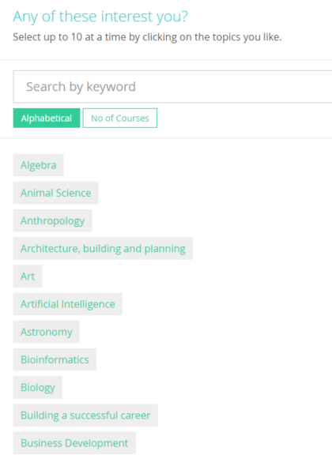
You can browse by topic and sort the list alphabetically or by the number of courses offered at the moment.
You can even search by a particular career
(e.g. accountant/engineer) or interest by typing into the search bar.
A maximum of 10 topics that interest you can then be selected. Click ‘next’ to continue.

Slide 43
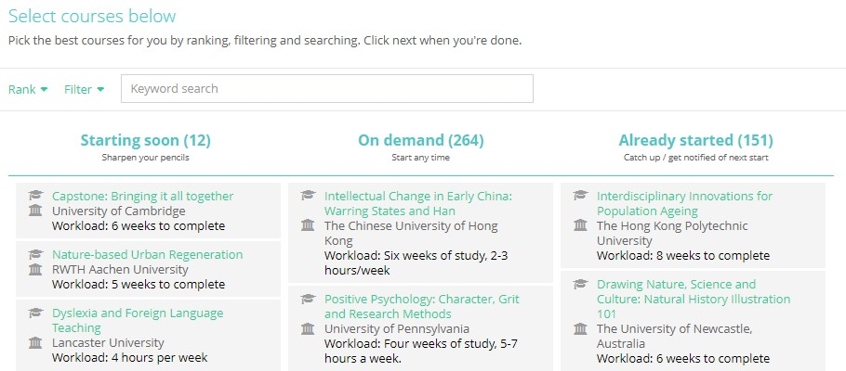
The Longlist page shows you all the current MOOCs for your chosen topics, sorted into three columns.
You can rank and filter courses to find the ones you’re most interested in.

Slide 44
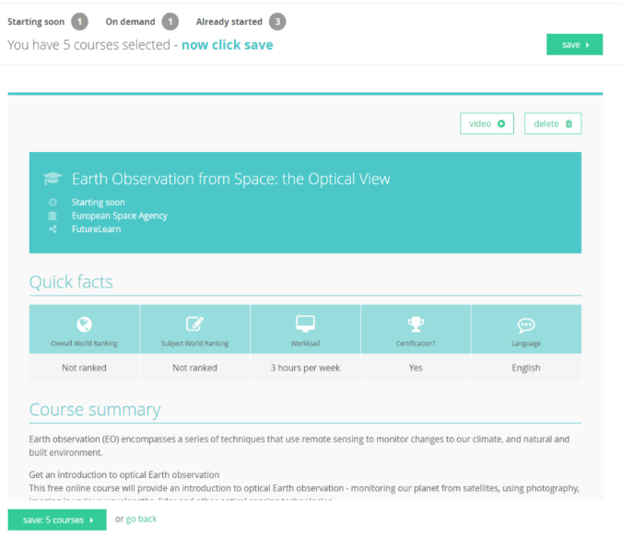
The Shortlist page allows you to see lots of information about each course.
At any point, you can go back to the Longlist to add in more courses. You can also delete courses from the Shortlist page.
Once you’re happy with the MOOCs on your shortlist, click ‘save’.

Slide 45
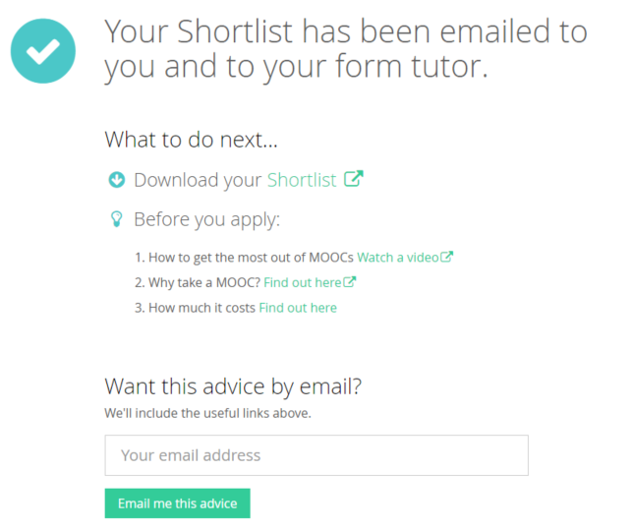
Afterwards, a copy of your shortlist will be emailed to you and your tutor. Click here to view it straight away or download.
This page also shows you some handy links, including why you should consider taking a MOOC!

Slide 46

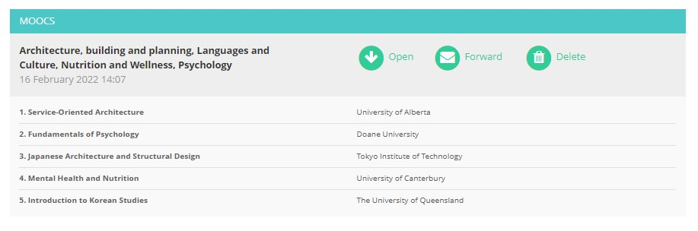
You can make as many MOOC shortlists as you like! And you can view them anytime by clicking on the ‘Favourites’ tab.

Slide 47
Exploring pathways
Recording what you’ve done
Searching for opportunities
Drafting application materials
Making applications
Careers library
Activities
UK universities
UK Personal Statement
Post 16/18 Intentions
Subjects library
Competencies
US universities
Academics
Locker
Know-how library
Interactions
European universities
CV / Resumé
Applications list
MOOC
Oxbridge
Common App Essay
Personality profile
Apprenticeships
US recommenders
Interests profile
College / Sixth Form
Notes for Ref Writers
Canadian universities
Asian universities
Australasian unis
Create an account
Special opportunities
Sign up
ME and African unis
Irish universities

Slide 48

Using the Personality profile

Slide 49

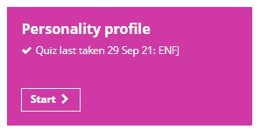
The Personality profile features a personality quiz.
The results of this quiz can then be used to search for careers and university subjects that are associated to your personality type!

Slide 50
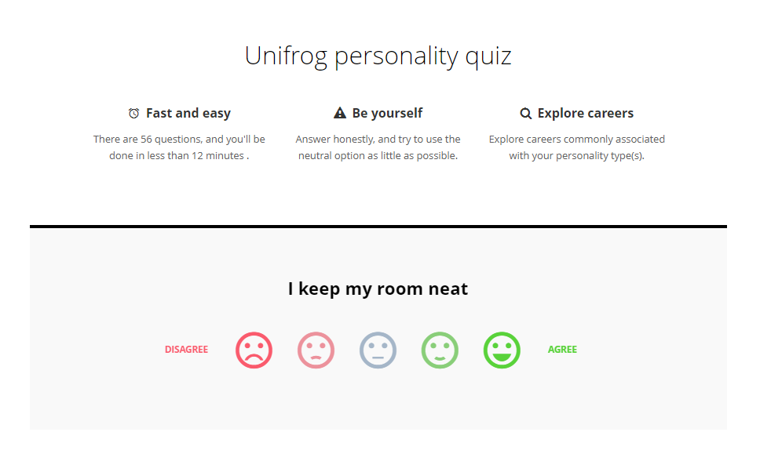
There are 56 questions in the quiz. They can be completed in 12 minutes.

Slide 51
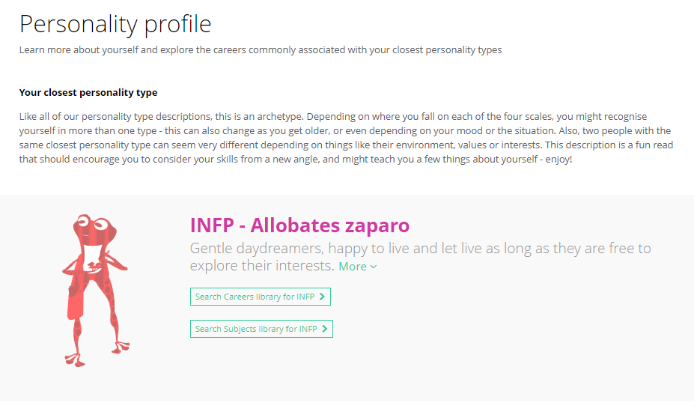
A personality profile will then be created based on your answers. You can then use this as a category to explore careers or subjects commonly associated with that personality type.

Slide 52

If you click on ‘More’, you will see a more detailed descripted of your personality type as well as some unscientific information such as which famous person has the same personality type to you!
You will also be shown which frog you’re most like!

Slide 53
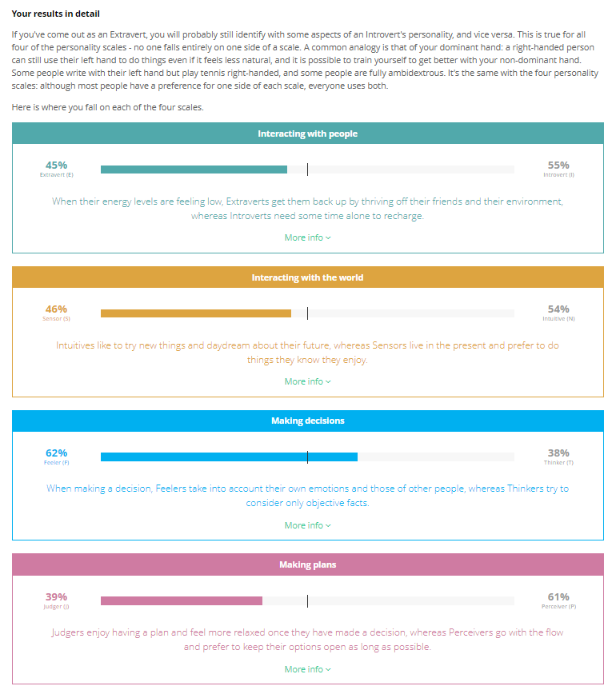
If you scroll further down the page, you will be able to view the letters that make up your personality type in more detail, with percentages to show where you personality type lies on a scale.

Slide 54
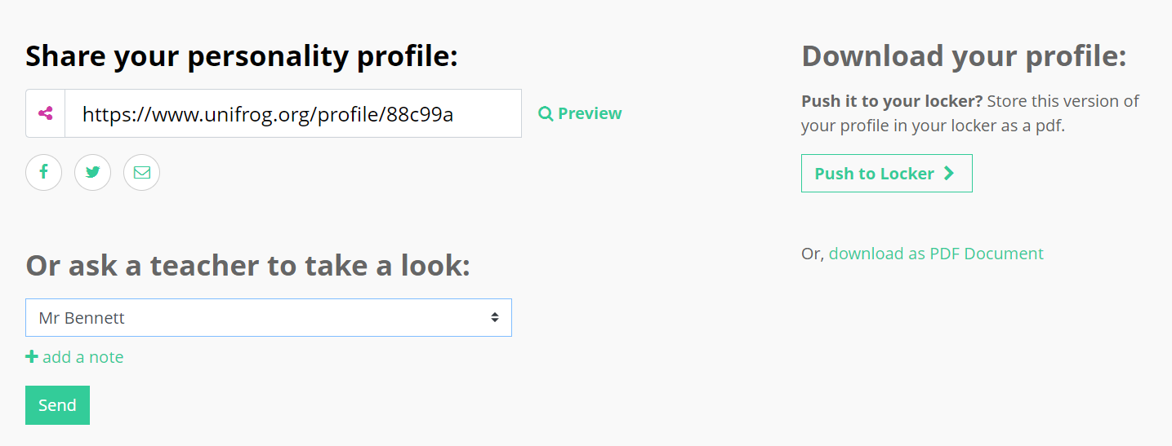
After the quiz, you’ll have the option to share your personality profile on social media, email it to anyone you like, or send it to a teacher for them to take a look.
You’re also able to download it and place it in your Locker.

Slide 55
Exploring pathways
Recording what you’ve done
Searching for opportunities
Drafting application materials
Making applications
Careers library
Activities
UK universities
UK Personal Statement
Post 16/18 Intentions
Subjects library
Competencies
US universities
Academics
Locker
Know-how library
Interactions
European universities
CV / Resumé
Applications list
MOOC
Oxbridge
Common App Essay
Personality profile
Apprenticeships
US recommenders
Interests profile
College / Sixth Form
Notes for Ref Writers
Canadian universities
Asian universities
Australasian unis
Create an account
Special opportunities
Sign up
ME and African unis
Irish universities

Slide 56

Interests profile

Slide 57

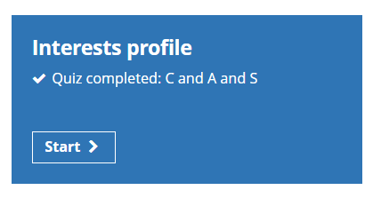
The Interests profile tool features an interests quiz based on Holland’s theory.
The theory is that the careers you’re likely to enjoy will be linked to your personality.
The results of this quiz will help you to explore careers and subjects best-suited to your personality. You might find some that you’ve never thought of before!

Slide 58
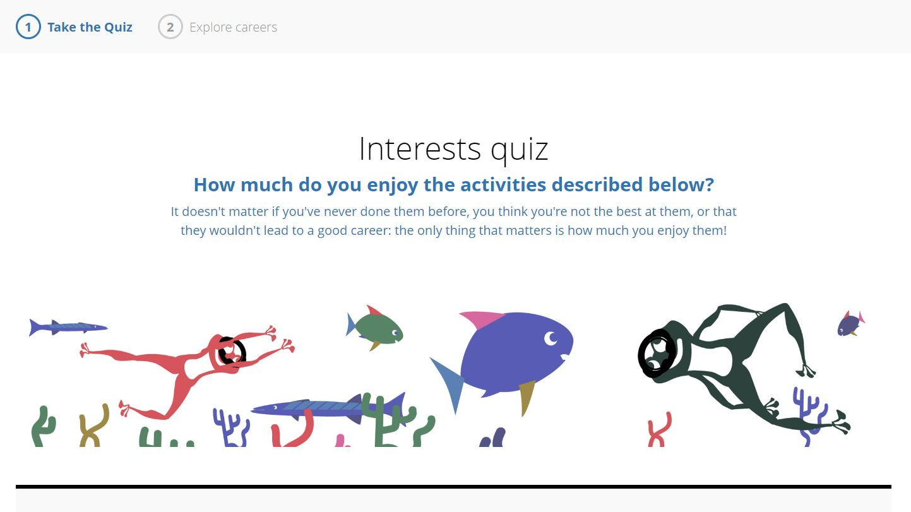
You’ll be asked a range of different questions. You can select whether you agree, disagree, or sit somewhere between those two points.

Slide 59
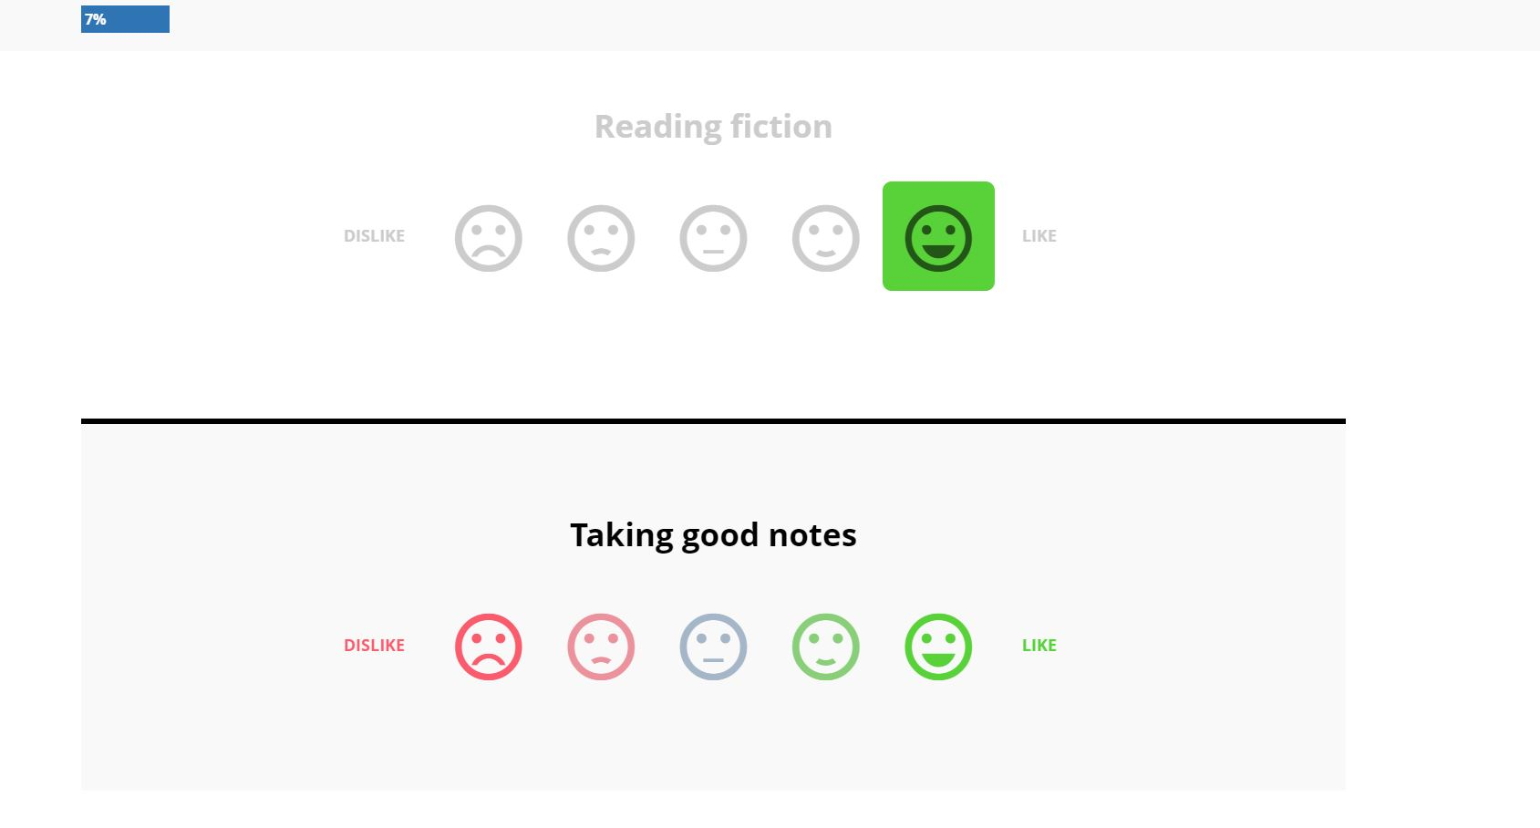
The blue progress bar at the top left hand side will increase as you answer the questions. The bar will continue to increase until you have finished the quiz and reached 100%!

Slide 60
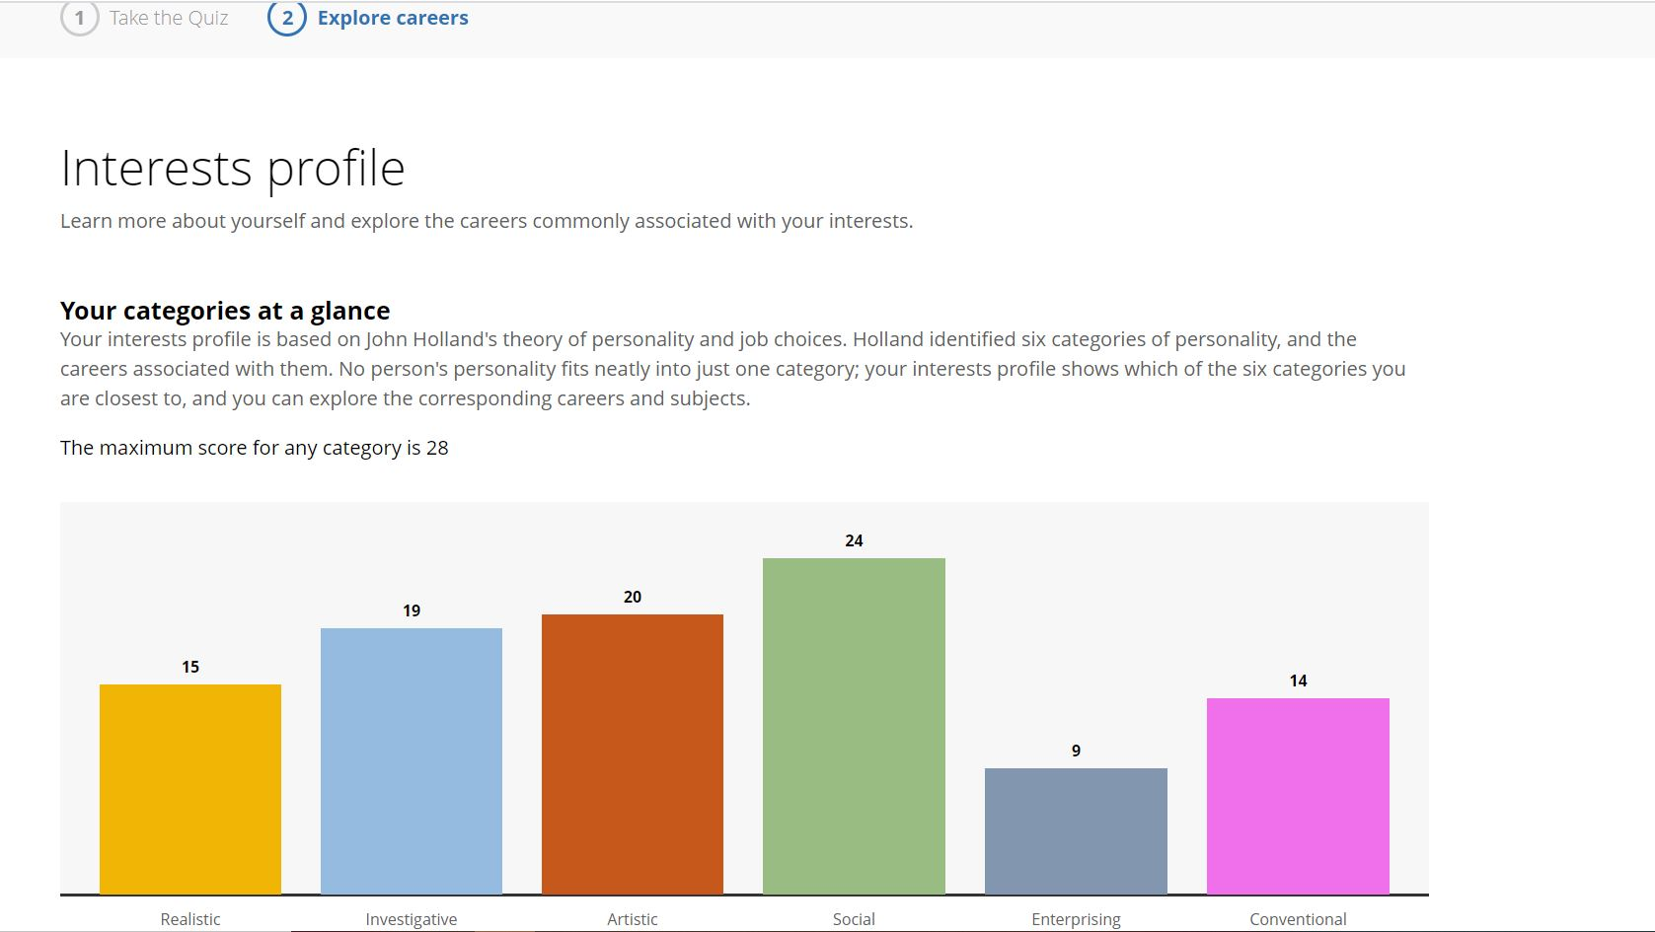
Once you’ve answered the questions, click ‘Get your results’. Here, your personality will be broken down into 6 categories and where you sit within each of them, based on your interests!

Slide 61
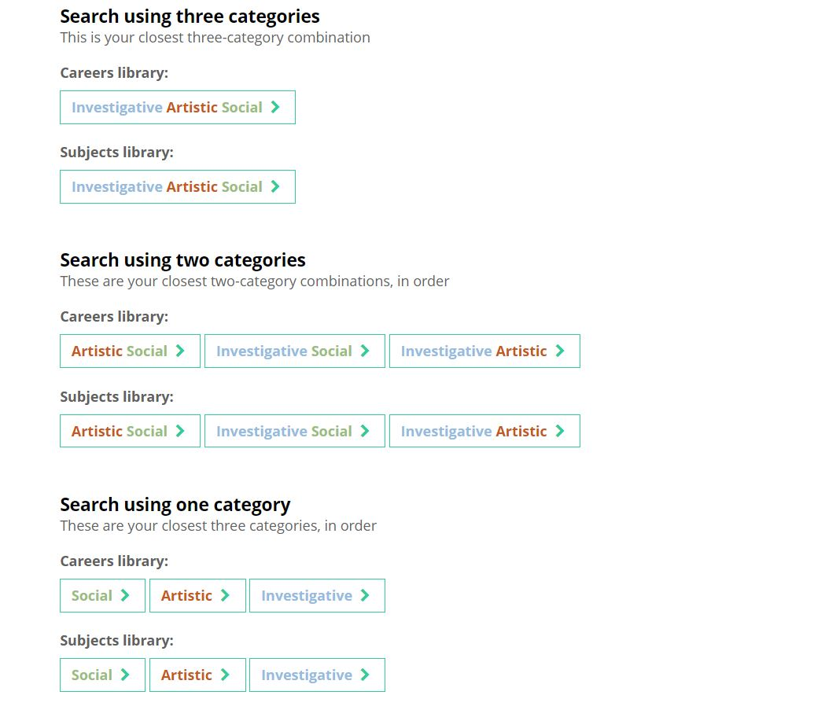
Using category combinations, you can search for careers and subjects that might be suited to you from the Careers and Subjects libraries.

Slide 62
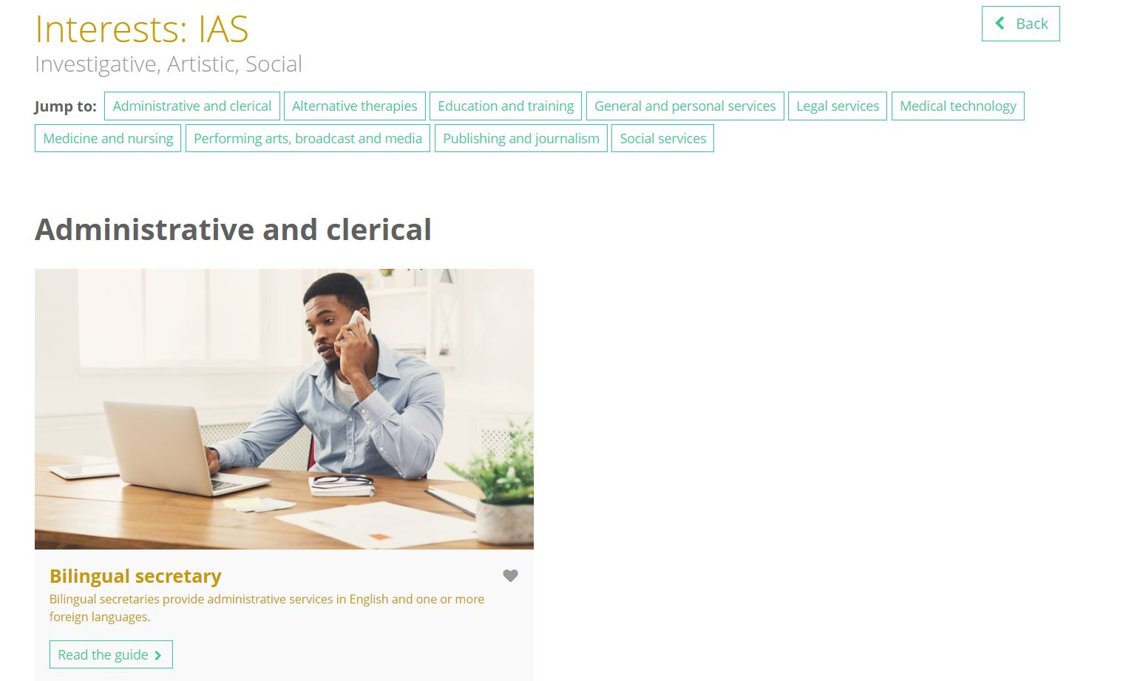
These links will take you directly to the Careers or Subjects library where you can find detailed information on these matched profiles.

Slide 63

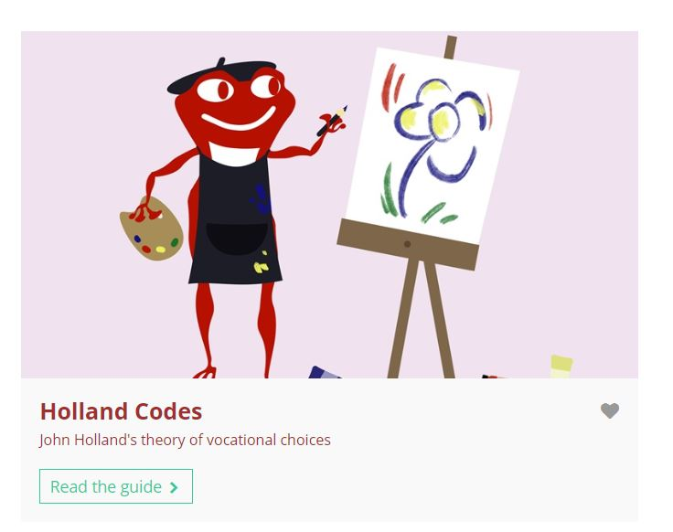
If you would like to find out about the theory behind the Interests quiz, you can click the ‘Know-how library’ link which will take you directly to the guide.
Here, you’re able to read the article explaining the background behind the Holland theory!

Slide 64
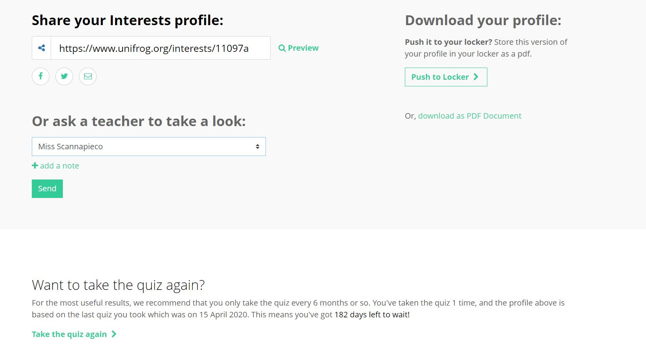
Your Interests profile can be saved as a PDF to be pushed to your Locker, or sent to a teacher.
The quiz can be done as many times as you like, just follow the link at the bottom of the page!

Slide 65
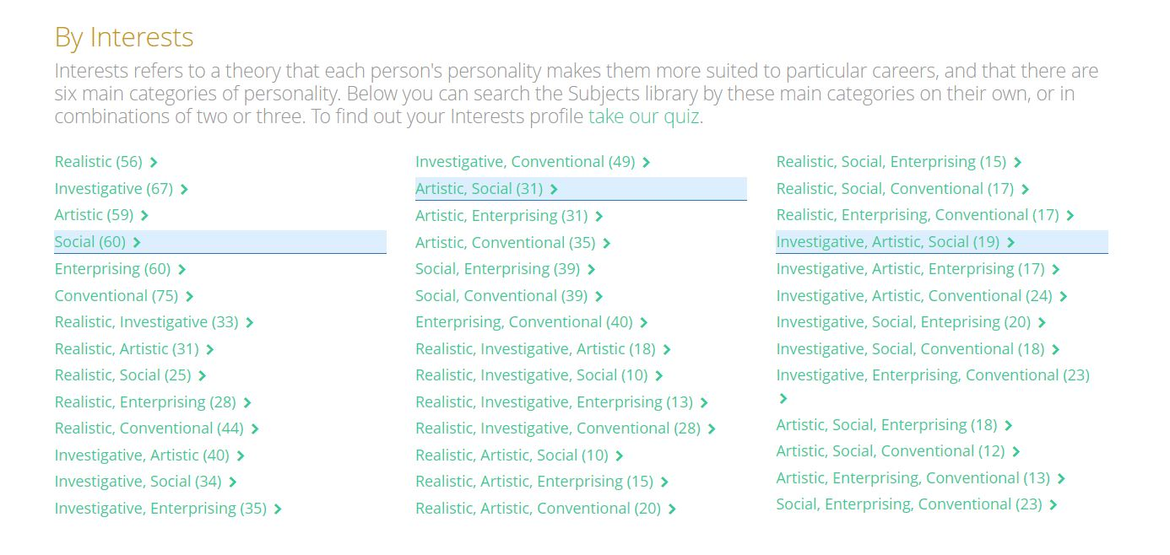
Once you’ve completed the Interests quiz, your personality categories will be highlighted in the Careers and Subject libraries.
Here you can find out more information about the careers and subjects most commonly associated with your personality!

Slide 66
Exploring pathways
Recording what you’ve done
Searching for opportunities
Drafting application materials
Making applications
Careers library
Activities
UK universities
UK Personal Statement
Post 16/18 Intentions
Subjects library
Competencies
US universities
Academics
Locker
Know-how library
Interactions
European universities
CV / Resumé
Applications list
MOOC
Oxbridge
Common App Essay
Personality profile
Apprenticeships
US recommenders
Interests profile
College / Sixth Form
Notes for Ref Writers
Canadian universities
Asian universities
Australasian unis
Create an account
Special opportunities
Sign up
ME and African unis
Irish universities

Slide 67
Recording what you’ve done

Slide 68


2) Recording what you have done
Use the tools in this section to get Recording what you have done, using guidance and examples and preparing yourself for making applications.
Our Tools:
Activities
Competencies
Interactions

Slide 69

Using the Activities tool

Slide 70


The Activities tool provides templates so you can record examples of activities that underline your personal experience, abilities, and accomplishments.
This will improve your job, apprenticeship, or university applications!

Slide 71
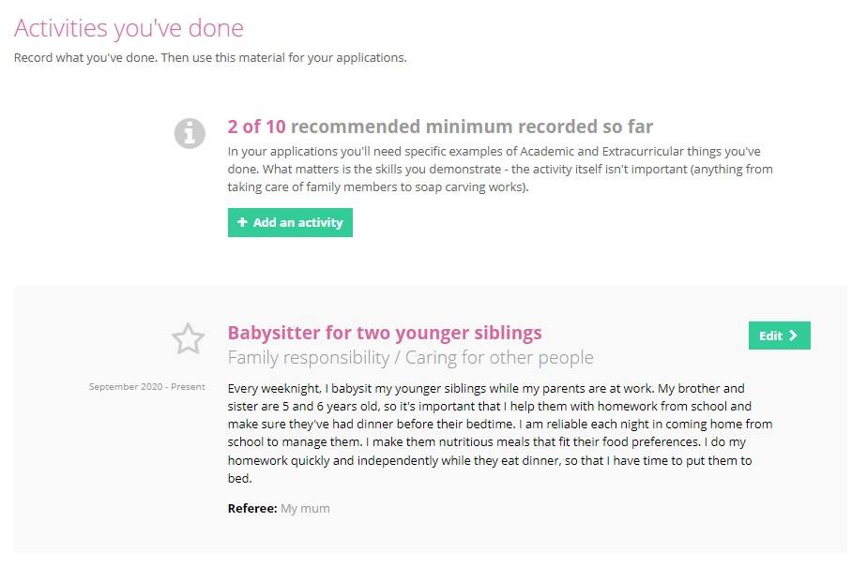
To begin, click on ‘Add an activity’ to take you to the template for recording your example.

Slide 72
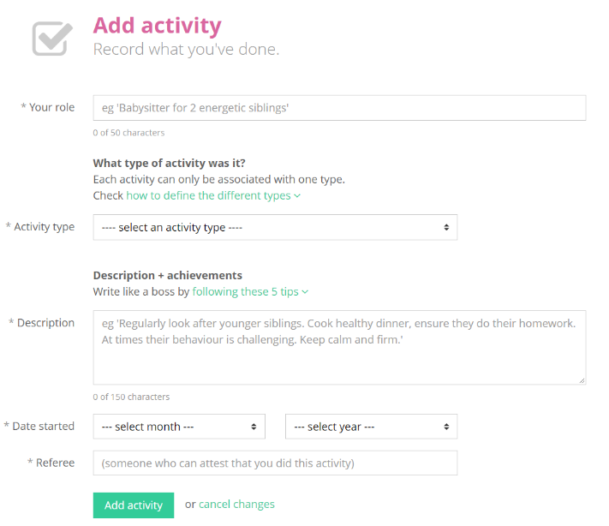
To complete an activity, state your role and select an activity type from the drop down menu.
If you need help on how to define the type of activity, use the guide which defines different types.

Slide 73
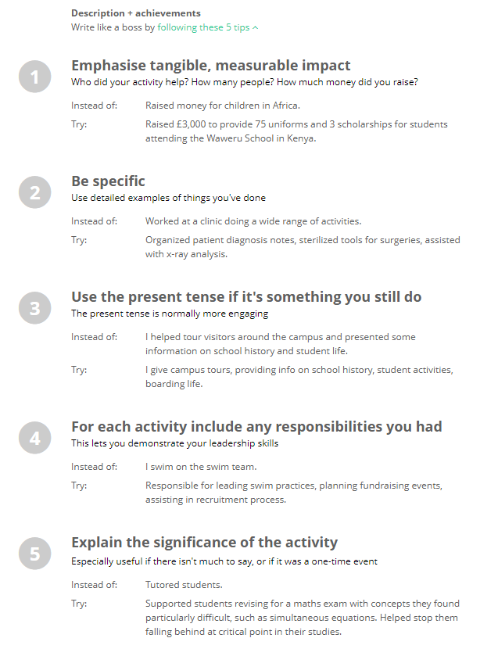
Then you need to write the description.
If you need them, there are tips on how to describe your examples expertly.
Do not try to use these as templates; the entries need to be personal to you!

Slide 74
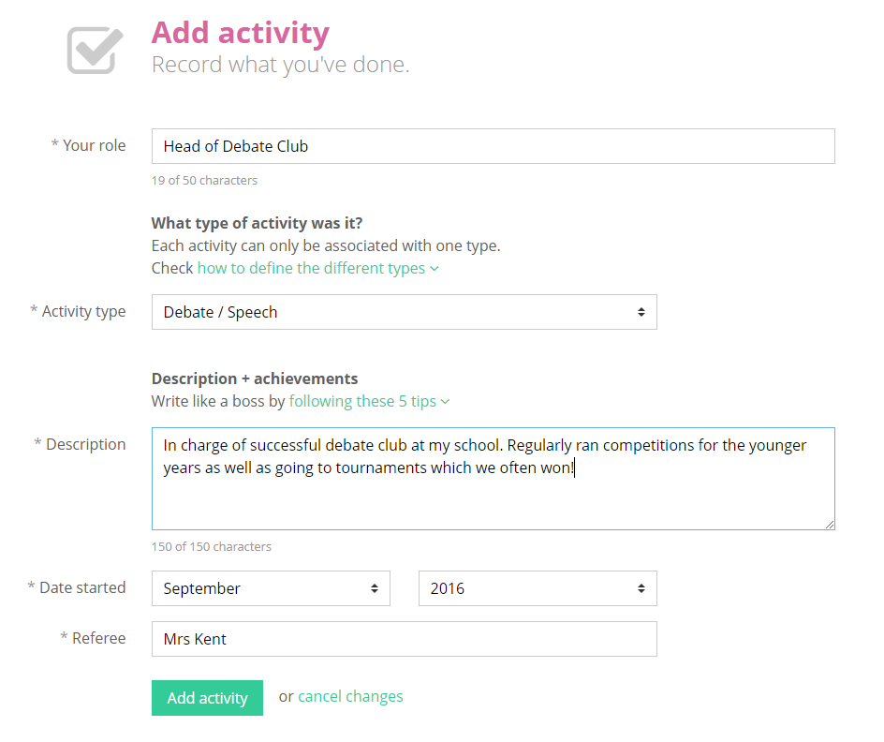
Once complete, click on ‘Add activity’ at the bottom of the page.

Slide 75
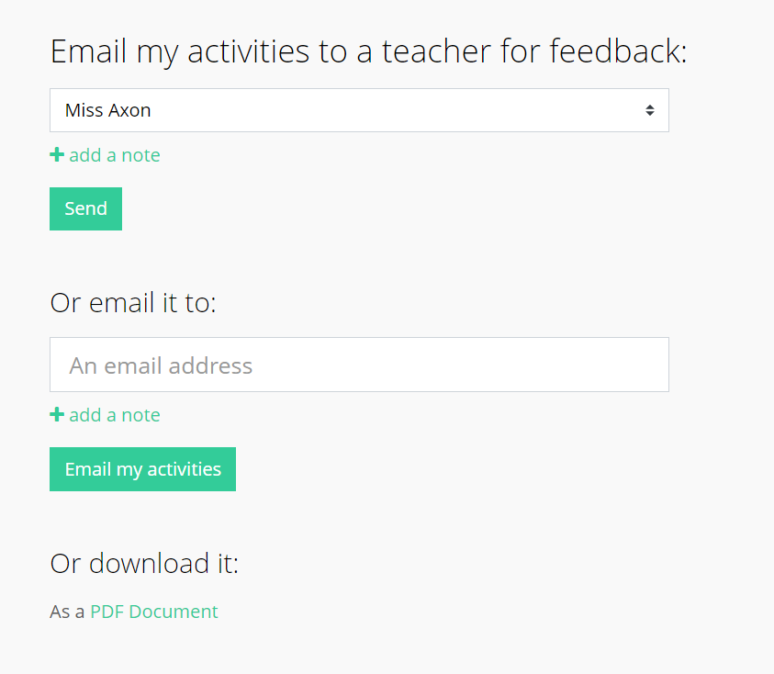
If you would like to share what you have written you can email it straight to your form tutor…
…or to anyone else by typing their email in!
You can also download what you have written.

Slide 76
Exploring pathways
Recording what you’ve done
Searching for opportunities
Drafting application materials
Making applications
Careers library
Activities
UK universities
UK Personal Statement
Post 16/18 Intentions
Subjects library
Competencies
US universities
Academics
Locker
Know-how library
Interactions
European universities
CV / Resumé
Applications list
MOOC
Oxbridge
Common App Essay
Personality profile
Apprenticeships
US recommenders
Interests profile
College / Sixth Form
Notes for Ref Writers
Canadian universities
Asian universities
Australasian unis
Create an account
Special opportunities
Sign up
ME and African unis
Irish universities

Slide 77

Using the Competencies tool

Slide 78

These are the 12 competencies that underpin success at every stage of life:
Aiming high | Creativity | Leadership | Listening
Speaking | Problem solving | Staying positive | Teamwork
Reading | Numeracy | Independence | Writing
Use the Unifrog Competencies tool to record your progress.

Slide 79
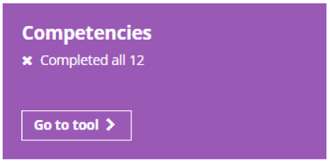
The Competencies tool allows you to record key competencies that universities and employers value, which is good preparation for writing strong personal statements, apprenticeship or job applications.
There are two versions of the Competencies tool:
With Competency levels turned off
With Competency levels turned on (partnership with Skills Builder)

Slide 80
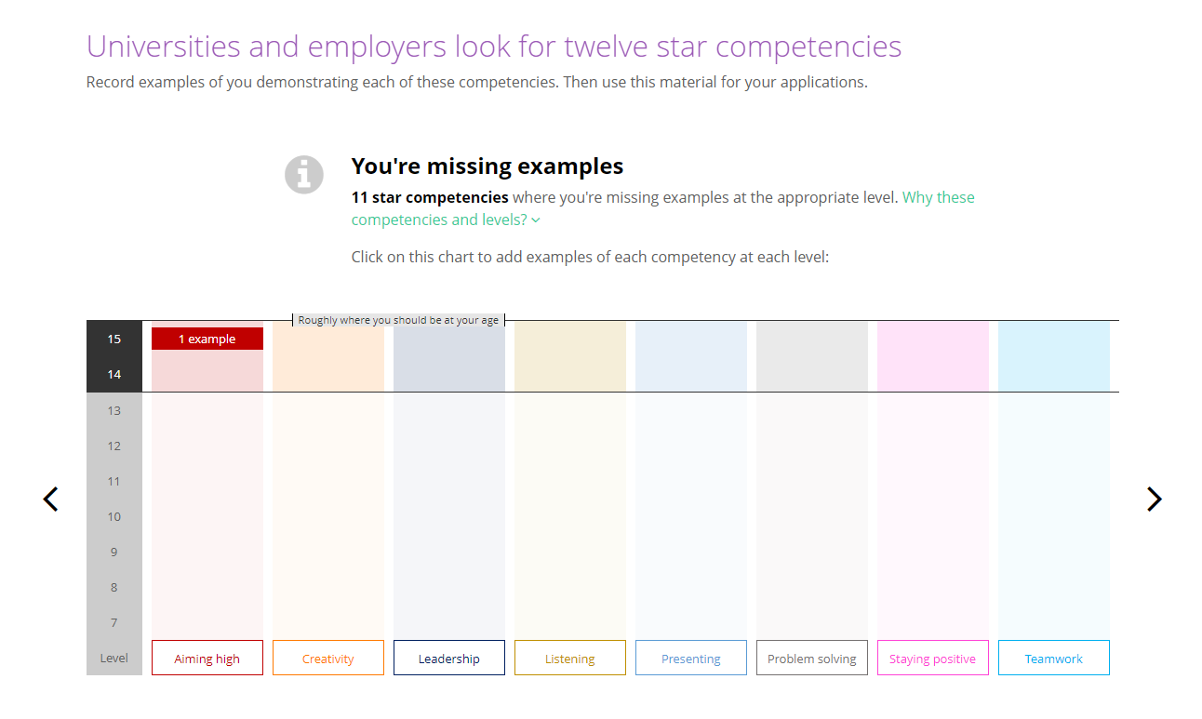
If you have levels turned on, you will see this chart when you click on the tool.
The chart enables you to view your progress with each key competency, see where you’re progressing well and areas in need of further development.

Slide 81
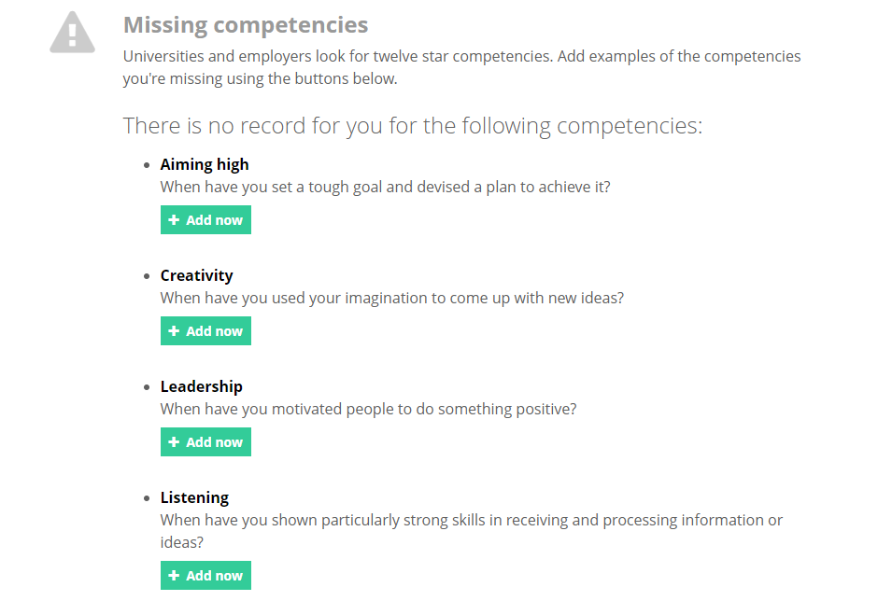
There are twelve key competencies which are considered crucial for students to demonstrate when thinking about their future careers.
You can add an example for each of these competencies.
To start to complete your competency list, click the green ‘+ Add now’ button.

Slide 82
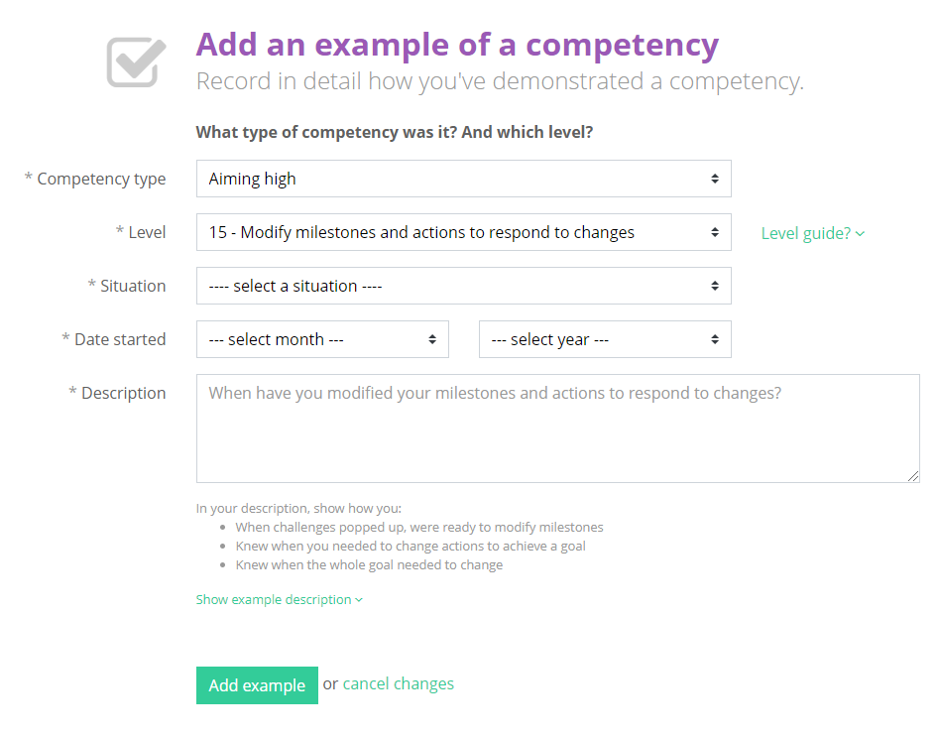
To complete a competency, select a situation and start date from the drop down menus. Then, select the relevant level.
Explain how you demonstrated this competency in detail.
If you need a structure to follow, use these bullet points as a guide.

Slide 83
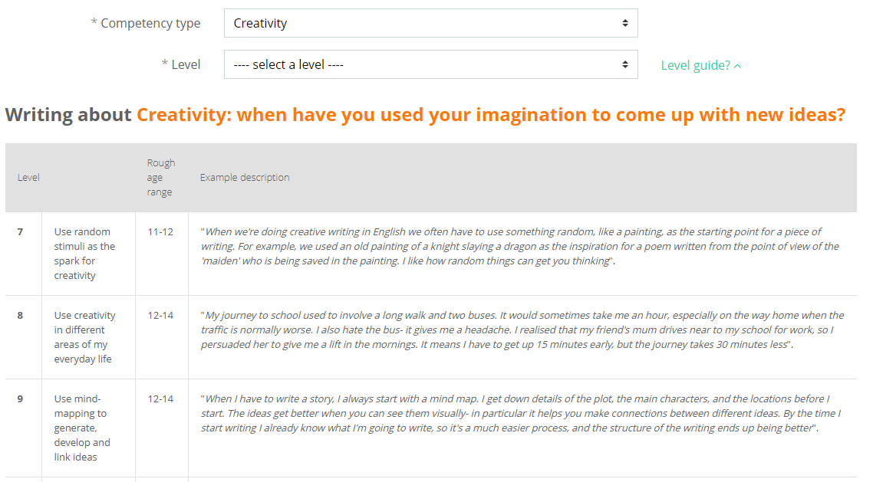
You will only be asked to select a level if you have levels turned on.
Students can click on ‘Level guide’ to expand a table which breaks down these skills into rough age ranges and offers examples for inspiration!
Students must not try to use these as templates; the entries need to be personal to them!

Slide 84
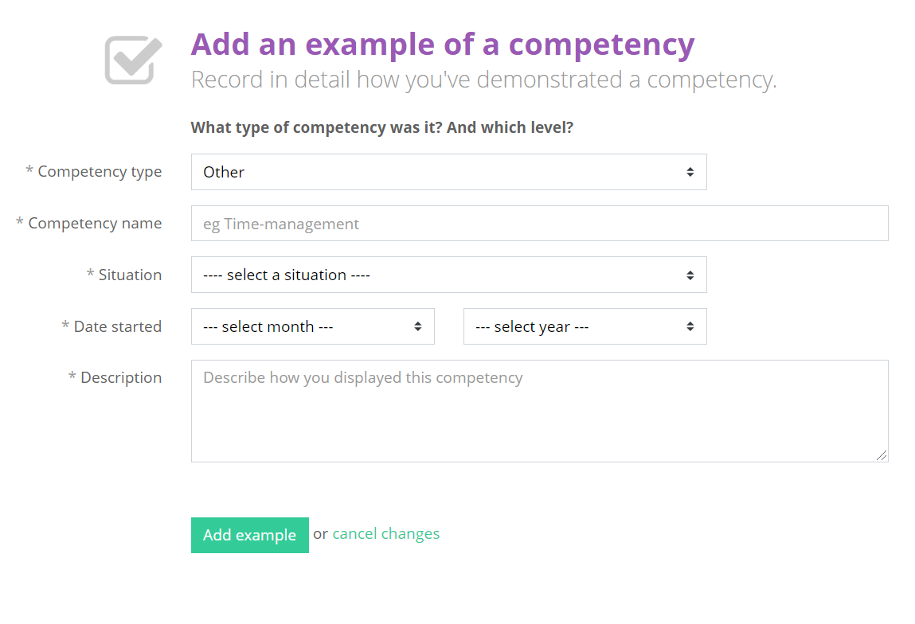
You can also add additional competencies of your own.
Click ‘+ Add example’ to create an additional competency to add to your list, and select ‘Other’ from the drop down list.
You won’t be asked to add a level and can use the CAR method (Context, Action, Result) to help structure your answer.

Slide 85
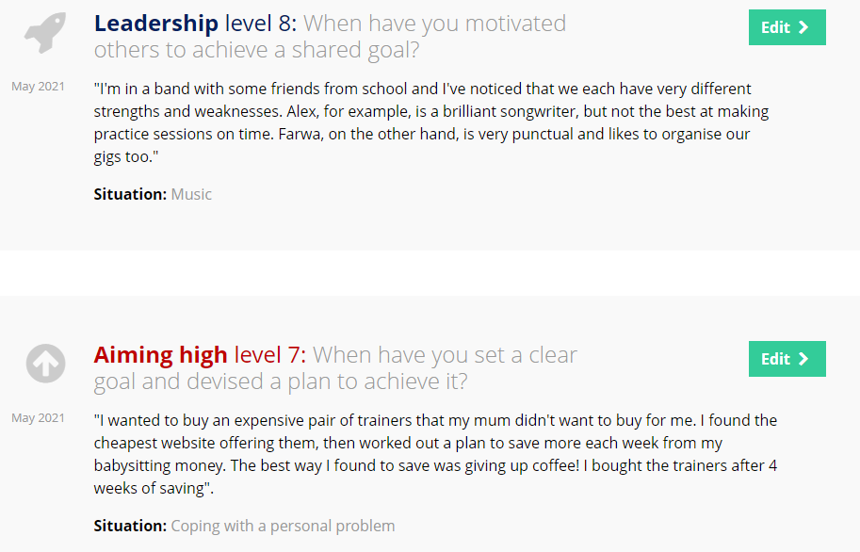
Repeat this process for each competency you want to add. You should try to do at least one for each category.

Slide 86
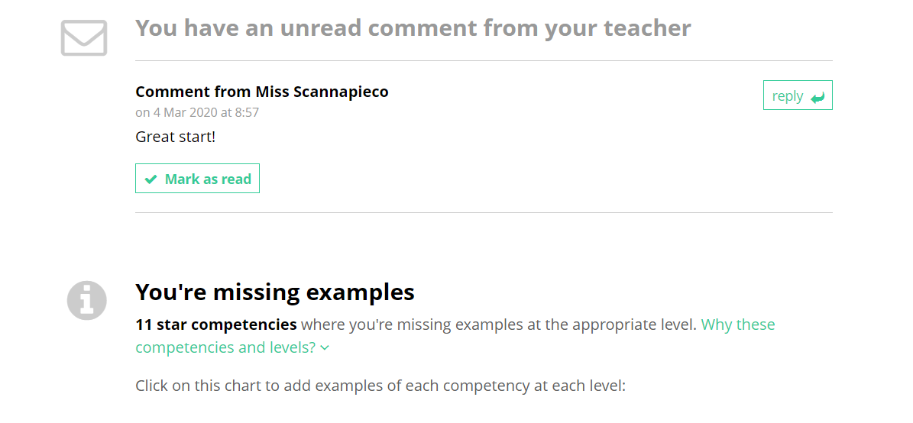
Your teachers are able to give you feedback on your competencies.
If you have received a comment you will be notified via your email and on your competencies page.
You are able to mark these comments as read to ensure you keep up-to-date.

Slide 87

If you would like to share what you have written you can email it straight to your form tutor or anyone else by typing their email in.
You can also download what you have written.

Slide 88
Exploring pathways
Recording what you’ve done
Searching for opportunities
Drafting application materials
Making applications
Careers library
Activities
UK universities
UK Personal Statement
Post 16/18 Intentions
Subjects library
Competencies
US universities
Academics
Locker
Know-how library
Interactions
European universities
CV / Resumé
Applications list
MOOC
Oxbridge
Common App Essay
Personality profile
Apprenticeships
US recommenders
Interests profile
College / Sixth Form
Notes for Ref Writers
Canadian universities
Asian universities
Australasian unis
Create an account
Special opportunities
Sign up
ME and African unis
Irish universities

Slide 89

Using the Interactions tool

Slide 90


The Interactions tool is a record of all the careers education and exposure that you receive.
The tool helps you to easily keep track of all these experiences!

Slide 91

Here you can see all the experiences you have had throughout school in relation to your future.
Teachers are able to leave comments on each interaction which you can reply to.

Slide 92

If you've already done something which hasn't been recorded, email your form teacher (or another teacher) to get it added in.
You can download all your interactions here.

Slide 93
Exploring pathways
Recording what you’ve done
Searching for opportunities
Drafting application materials
Making applications
Careers library
Activities
UK universities
UK Personal Statement
Post 16/18 Intentions
Subjects library
Competencies
US universities
Academics
Locker
Know-how library
Interactions
European universities
CV / Resumé
Applications list
MOOC
Oxbridge
Common App Essay
Personality profile
Apprenticeships
US recommenders
Interests profile
College / Sixth Form
Notes for Ref Writers
Canadian universities
Asian universities
Australasian unis
Create an account
Special opportunities
Sign up
ME and African unis
Irish universities

Slide 94
Searching for opportunities

Slide 95
3) Searching for opportunities
Use the tools in the Searching for opportunities section to compare courses, apprenticeship openings and colleges.
Our Tools:
UK universities
Canadian universities
US universities
Asian universities
European universities
Australasian unis
Oxbridge
Special opportunities
Apprenticeships
ME and African unis
College / Sixth Form
Irish universities

Slide 96

Using the UK universities tool

Slide 97


The UK universities tool allows you to search for every undergraduate course offered in the UK by using unique filtering and ranking facilities.
These let you focus on key areas of interest that are relevant to you!

Slide 98

Please familiarise yourself with some of the important details about university study.
You need to take these factors into consideration when making your applications.
Once you have completed reading, click ‘Next’ at the bottom of the page.

Slide 99

Here you put in where you usually live.
This is going to affect some of the fee information you will see.

Slide 100

If you are KS5 student, select the qualifications and highest grades that you are likely to have at the end of year 13. The points next to the grades indicate UCAS points in order to apply for UK universities.
You should not include AS levels.
If you are in KS3 or KS4, you should enter your GCSEs.

Slide 101

Enter a broad subject area that you are interested in. If you know the exact course you wish to study, you can enter that too.

Slide 102

A direct match for the subject you typed in will be displayed. This will also show you other courses which involve that subject in some way.
Now select any specific subjects that you are interested in. You can pick up to ten courses at a time. Once you have selected all your courses click ‘next’.

Slide 103

There are three categories based on your grades and the entry requirements for the course. Pick as many as you like but try to have at least one in each column.
Your grades will be used to categorise the universities into those which will be aspirational, solid and safe for you.
The little red dots with an exclamation mark mark courses that are not only top of your range, but noted to be out of your range.

Slide 104

You can rank and filter courses to narrow and personalise your search criteria. You may want to click on the filter that gets rid of courses out of your range, for example.
Use the filters to only show courses which suit your needs and preferences. For example you may wish to only see courses at Russell Group universities, or sandwich courses.

Slide 105

You can then use the ‘Rank’ options to see where the different courses fall within different criteria. Select a few courses, and click ‘next’.

Slide 106

Scrolling down allows you to see lots of detailed impartial information about each course and some links below in green which will help you do more research – the university website, the course page, open days, finance page and disabilities page.
Once you are happy with the courses on your shortlist, click ‘save’.

Slide 107

The map at the top of the screen shows you the locations of the university courses that are on your shortlist (red markers), as well as your location (blue marker).
You can click on a red marker, and click on ‘More info’, which will take you straight down to the course on your shortlist. Alternatively, you can just scroll down to view all the courses in your shortlist.

Slide 108

A copy of your shortlist will be emailed to you. Click to view it straight away and download your shortlist as a PDF file.
This page also links to our Know-how library giving you a wealth of further advice about university, including information on finance, the application process etc.

Slide 109

Remember, you can make as many shortlists as you like, and can view them any time by clicking on the ‘Favourites’ button on the main dashboard.

Slide 110
Exploring pathways
Recording what you’ve done
Searching for opportunities
Drafting application materials
Making applications
Careers library
Activities
UK universities
UK Personal Statement
Post 16/18 Intentions
Subjects library
Competencies
US universities
Academics
Locker
Know-how library
Interactions
European universities
CV / Resumé
Applications list
MOOC
Oxbridge
Common App Essay
Personality profile
Apprenticeships
US recommenders
Interests profile
College / Sixth Form
Notes for Ref Writers
Canadian universities
Asian universities
Australasian unis
Create an account
Special opportunities
Sign up
ME and African unis
Irish universities

Slide 111

Using the US universities tool

Slide 112


The US universities tool allows you to search for every undergraduate course offered in the US.
You can use unique filtering and ranking tools to narrow down your choice to the courses that suit you best!

Slide 113

Familiarise yourself with some of the important details about study in the US listed on this first page.
You need to take these comparisons into consideration when applying for US universities.
Once you have completed reading, click ‘Next’.

Slide 114

You will be able to choose between whether you’re a US citizen or not.
This affects the fee and financial aid information you see.

Slide 115

You’ll see a list of subjects available for you to major in. Select the subject that interests you.
You can continue if you’d prefer to not choose a subject yet.
Rank the subjects on different factors, and use the search bar to help you narrow down the list.
When you are happy with your choices, click ‘Next’.

Slide 116

Select the category that best matches the qualifications and highest grades you are likely to have at the end of Year 13.
Your grades will be used to categorise the universities into those which will be aspirational, solid, and safe for you.

Slide 117

This map shows you the various regions across the US available for you to study in.
You can choose which regions do and don’t suit you.
Any part of the country in green means it is selected and anything grey is omitted from the search.

Slide 118

US universities are often ranked academically by the SAT scores of the students they accept.
The SAT 25th/75th percentile is a statistic you’ll commonly see. It means that 50% of the students at the university scored those grades.
This gives you a good indication of the score you should be aiming for if you want to get into that university.

Slide 119
All the courses for your subjects are sorted into three categories based on your grades and the entry requirements for the course.
Pick as many as you like, but try to have at least one in each column.
You can rank and filter courses to narrow and personalise your search criteria.

Slide 120

This map shows you the locations of the courses that are on your shortlist.
You can click on a red marker, and click on ‘More info’. This will take you straight down to the course on your shortlist. Alternatively, you can just scroll down to view all the courses in your shortlist.

Slide 121

Scrolling down allows you to see lots of detailed impartial information about each course.
Don’t forget that at any point you can always click go back to edit or delete your choices.

Slide 122

Your shortlist has lots more detailed information. Make sure you scroll down to see it all!
Once you’re happy with the courses on your shortlist, click ‘save’!

Slide 123

A copy of your shortlist will be emailed to you. Click to view it straight away and download your shortlist as a PDF file.
This page also links to our Know-how library, giving you a wealth of further advice about university.
Guides include information on finance, the application process, and more!

Slide 124

Remember you can make as many shortlists as you like! A you can view them any time by clicking on the ‘Favourites’ tab on the main dashboard.

Slide 125
Exploring pathways
Recording what you’ve done
Searching for opportunities
Drafting application materials
Making applications
Careers library
Activities
UK universities
UK Personal Statement
Post 16/18 Intentions
Subjects library
Competencies
US universities
Academics
Locker
Know-how library
Interactions
European universities
CV / Resumé
Applications list
MOOC
Oxbridge
Common App Essay
Personality profile
Apprenticeships
US recommenders
Interests profile
College / Sixth Form
Notes for Ref Writers
Canadian universities
Asian universities
Australasian unis
Create an account
Special opportunities
Sign up
ME and African unis
Irish universities

Slide 126

Using the European universities tool

Slide 127


The European universities tool allows you to research all of the English-taught undergraduate courses from hundreds of universities, in multiple countries in Europe.
It will also provide you with guidance on international entry requirements.

Slide 128

The first page contains some interesting facts and information about Europe. This may help you to decide if it is somewhere you would like to study. Once you’ve finished reading, click ‘next’ at the bottom of the page.

Slide 129

Course tuition fees and access to financial aid depend on which country you are from.
Select the relevant options from the dropdown menus, and click ‘next’ at the bottom to continue.

Slide 130

Here you can pick up to 10 subject areas that you are considering studying.
These can be ranked by subject area, alphabetically, or by the number of courses taught in English. And don’t forget that you can always search by keyword!

Slide 131

The Longlist shows all the courses for your chosen subject(s). They are split across three columns according to their location in Europe.
You can rank and filter the courses to find the best ones for you.
Click on a course to add it to your shortlist selection.

Slide 132

The map at the top of the next screen shows you the locations of your selected universities.
You can click on a red marker, and then on on ‘More info’, which will take you straight down to the course on your shortlist.
Alternatively, you can just scroll down to view all the courses in your shortlist.

Slide 133

Scrolling down the Shortlist shows you more information about each course and the university. There’s a wealth about the town and country of your selected course, and in some cases a video.
At any point, you can go back to the Longlist to add more courses to your shortlist or delete courses from your shortlist.
Once you’re happy with the courses on your shortlist, click ‘save’.

Slide 134

A copy of your shortlist will be emailed to you. You can also view it straight away by clicking on the ‘Download your Shortlist’ button.
Visit the Know-how library for further information. You’ll find guides on applying for and studying at a European university.

Slide 135

Remember you can make as many shortlists as you like! And can view them any time by clicking on the ‘Favourites’ tab on the main dashboard.

Slide 136
Exploring pathways
Recording what you’ve done
Searching for opportunities
Drafting application materials
Making applications
Careers library
Activities
UK universities
UK Personal Statement
Post 16/18 Intentions
Subjects library
Competencies
US universities
Academics
Locker
Know-how library
Interactions
European universities
CV / Resumé
Applications list
MOOC
Oxbridge
Common App Essay
Personality profile
Apprenticeships
US recommenders
Interests profile
College / Sixth Form
Notes for Ref Writers
Canadian universities
Asian universities
Australasian unis
Create an account
Special opportunities
Sign up
ME and African unis
Irish universities

Slide 137

Using the Oxbridge tool

Slide 138


The Oxbridge tool offers a direct and easy comparison between Oxford and Cambridge.
It does this by using unique filtering and ranking tools to narrow in on specific college qualities that appeal to you!

Slide 139

The first page compares Oxford and Cambridge at a glance on a range of features. It includes world ranking, average UCAS points per student, and even boat race victories!
Remember you will only be able apply to either Oxford or Cambridge.

Slide 140

You can rank the courses by typical offers and the acceptance rate.
The dark blue tick indicates that a course is taught at Oxford. The light blue tick indicates that it’s taught at Cambridge.
You will only be able to pick one course on this page.

Slide 141

On the Longlist you can see all the colleges at Oxford and Cambridge that provide the course you selected.
You can rank and filter the colleges to find the best ones for you.

Slide 142


At the top of the next page, the maps show you:
Red markers – the colleges you’ve selected
Blue markers – the main faculty building for the subject you’ve selected

Slide 143

Scrolling down the Shortlist shows you more information about each college.
At any point you can go back to the Longlist to add more colleges to the Shortlist. You can also delete colleges from the Shortlist.
Once you’re happy with the colleges on your shortlist, click ‘save’.

Slide 144

A copy of your shortlist will be emailed to you. Click to view it straight away and download your shortlist as a PDF file.
This page also links to our Know-how library, giving you a wealth of further advice on applying to Oxbridge.

Slide 145

Remember you can make as many shortlists as you like, and can view them any time by clicking on the Shortlist tab or the ‘view shortlist’ button on the main dashboard.

Slide 146
Exploring pathways
Recording what you’ve done
Searching for opportunities
Drafting application materials
Making applications
Careers library
Activities
UK universities
UK Personal Statement
Post 16/18 Intentions
Subjects library
Competencies
US universities
Academics
Locker
Know-how library
Interactions
European universities
CV / Resumé
Applications list
MOOC
Oxbridge
Common App Essay
Personality profile
Apprenticeships
US recommenders
Interests profile
College / Sixth Form
Notes for Ref Writers
Canadian universities
Asian universities
Australasian unis
Create an account
Special opportunities
Sign up
ME and African unis
Irish universities

Slide 147

Using the Apprenticeships tool

Slide 148


The Apprenticeships tool is a uniquely comprehensive list of apprenticeships offered in the UK.
It allows you to research and consider all the opportunities out there to find the best one that suits you!

Slide 149

Familiarise yourself with some of the important details about apprenticeships on the first page.
You need to take these factors into consideration when making your applications.
Once you have completed reading, click ‘Next’ at the bottom of the page.

Slide 150

You’ll see a list of standards/frameworks that you can do an apprenticeship in. Select those that interest you, up to a maximum of 10.
You’re able to rank these based on different factors, and use the search bar to type in a keyword.
When you are happy with your choices click ‘Next’.

Slide 151


The map on the next page
allows you to narrow your search depending on distance limits as a mile radius from your postcode.
You can change your postcode on this page too.
Once you have selected a mile radius, click ‘next’.

Slide 152

This page shows all the live apprenticeships that match your chosen frameworks.
As a general rule you should be picking apprenticeships from one or two columns.
You can rank and filter courses to find the ones that suit you best.

Slide 153

The map at the top of the next screen shows you the locations of the apprenticeship vacancies that are on your shortlist (red markers), as well as your location (blue marker).
You can click on a red marker, and click on ‘More info’, which will take you straight down to the vacancy on your shortlist. Alternatively, you can just scroll down to view all the vacancies in your shortlist.

Slide 154

Scrolling down allows you to see lots of detailed impartial information about each apprenticeship, including the training given and qualifications you will receive.
Don’t forget that at any point you can go back to edit your choices or delete them.
Once you’re happy with the vacancies on your shortlist page, click ‘save’.

Slide 155

A copy of your shortlist will be emailed to you as well as your tutor.
Click here to view straight away and download.
You can also apply for your chosen apprenticeships right here.

Slide 156

Remember you can make as many shortlists as you like! And you can view them any time by clicking on the ‘Favourites’ tab on the main dashboard.

Slide 157
Exploring pathways
Recording what you’ve done
Searching for opportunities
Drafting application materials
Making applications
Careers library
Activities
UK universities
UK Personal Statement
Post 16/18 Intentions
Subjects library
Competencies
US universities
Academics
Locker
Know-how library
Interactions
European universities
CV / Resumé
Applications list
MOOC
Oxbridge
Common App Essay
Personality profile
Apprenticeships
US recommenders
Interests profile
College / Sixth Form
Notes for Ref Writers
Canadian universities
Asian universities
Australasian unis
Create an account
Special opportunities
Sign up
ME and African unis
Irish universities

Slide 158

Using the College / Sixth Form tool

Slide 159


The College / Sixth Form tool is a uniquely comprehensive live feed of college courses in the UK.
It allows you to research the opportunities available to you and pick courses that suit you best!

Slide 160

The first page gives you extra information about the process.
Please familiarise yourself with some of the important details about colleges / sixth forms.
You need to take these factors into consideration when making your applications.

Slide 161

You’ll see a list of courses. You can use the search bar to type in a keyword.
Alternatively, you can sort this list by subject area, alphabetically, by the number of courses offered at the moment, average salary upon completion, or the numbers of jobs.
Select topics that interest you, up to a maximum of 10.

Slide 162

The map on the next page
allows you to narrow your search depending on distance limits as a mile radius from your postcode.
You can change your postcode on this page too.
Once you’ve selected a mile radius, click ‘next’.

Slide 163

The Longlist page shows you all the current courses for your chosen topics, sorted into three columns based on the level of qualification.
You can rank and filter courses to find the ones you’re most interested in.

Slide 164

The map at the top of the next screen shows you the locations of the courses that are on your shortlist (red markers), as well as your location (blue marker).
If you click on a red marker, and click ‘More info’, you’ll be taken straight to the course on your shortlist. Alternatively, you can just scroll down to view all the courses in your shortlist.

Slide 165

Scrolling further down the Shortlist page allows you to see lots of impartial information about each course.
At any point, you can go back to the Longlist to add in more courses. From the Shortlist page you can also delete courses.
Once you are happy with the courses on your shortlist, click ‘save’.

Slide 166

A copy of your shortlist will be emailed to you. Click here to view it straight away and download your shortlist as a PDF file.
This page also links to our Know-how library, giving you a wealth of further advice on applying to colleges and sixth forms.

Slide 167

Remember you can make as many shortlists as you like, and you can view them any time by clicking on the ‘Favourites’ tab on the main dashboard.

Slide 168
Exploring pathways
Recording what you’ve done
Searching for opportunities
Drafting application materials
Making applications
Careers library
Activities
UK universities
UK Personal Statement
Post 16/18 Intentions
Subjects library
Competencies
US universities
Academics
Locker
Know-how library
Interactions
European universities
CV / Resumé
Applications list
MOOC
Oxbridge
Common App Essay
Personality profile
Apprenticeships
US recommenders
Interests profile
College / Sixth Form
Notes for Ref Writers
Canadian universities
Asian universities
Australasian unis
Create an account
Special opportunities
Sign up
ME and African unis
Irish universities

Slide 169

Using the Canadian university tool

Slide 170


The Canadian universities tool allows you to research every English-taught undergraduate program offered in Canada.
You can use its unique filtering and ranking tools to allow you to focus on key areas of interest and things that suit you best!

Slide 171

Familiarise yourself with some of the important details about study in Canada listed on this page.
You need to take these comparisons into consideration when applying for Canadian universities.
Once you have completed reading, click ‘Next’.

Slide 172

Enter your nationality. This is going to affect some of the fee information you will see later on in the tool.

Slide 173

Select the category that best matches the qualifications and highest grades you are likely to have at the end of year 13.
Your grades will be used to determine the universities available for you.

Slide 174

You’ll see a list of subjects that you can choose to do a program with or major in. You can only select one here.
Search the subjects by subject area, alphabetically, or use the search bar to type in a keyword. The subjects that are linked to that keyword will then appear.
Selecting your subject will take you to the next step.

Slide 175

All the programs for your subjects are sorted into three categories based on region.
Pick as many as you like!
You can rank and filter courses to narrow down options and personalise your search criteria.

Slide 176

The map at the top of the next screen shows you the locations of the programs that are on your shortlist.
You can click on a red marker, and click on ‘More info’, which will take you straight down to the program on your shortlist. Alternatively, you can just scroll down to view all the programs in your shortlist.

Slide 177

Scrolling further down the Shortlist page allows you to see lots of impartial information about each program.
At any point you can go back to the Longlist to add in more programs. From the Shortlist page you can also delete programs.
Once you are happy with the courses on your shortlist, click ‘save’.

Slide 178

Afterwards, a copy of your shortlist will be emailed to you. Click here to view it straight away.
This page also links to our Know-how library, giving you a wealth of further advice on applying to Canadian universities.

Slide 179

Remember you can make as many shortlists as you like! And you can view them any time by clicking on the ‘Favourites’ tab on the main dashboard.

Slide 180
Exploring pathways
Recording what you’ve done
Searching for opportunities
Drafting application materials
Making applications
Careers library
Activities
UK universities
UK Personal Statement
Post 16/18 Intentions
Subjects library
Competencies
US universities
Academics
Locker
Know-how library
Interactions
European universities
CV / Resumé
Applications list
MOOC
Oxbridge
Common App Essay
Personality profile
Apprenticeships
US recommenders
Interests profile
College / Sixth Form
Notes for Ref Writers
Canadian universities
Asian universities
Australasian unis
Create an account
Special opportunities
Sign up
ME and African unis
Irish universities

Slide 181

Using the Asian university tool

Slide 182


The Asian universities tool allows you to research all of the English-taught undergraduate programs from hundreds of universities, in multiple countries in Asia.
It will also provide you with guidance on international entry requirements.

Slide 183

The first page lists a range of benefits to studying in Asia, including top ranking universities, travel, digital innovation, and food. This minght help you to decide if it is somewhere you would like to study!
Once you have completed reading, click ‘Next’.

Slide 184

Enter your citizenship and the curriculum you study.
This will affect some of the deadlines and fee information you’ll see later on in the tool.

Slide 185

On the next page, pick up to 10 subject areas that you are considering studying.
These can be ranked by subject area, alphabetically, or by the number of programs offered. And don’t forget that you can always search by keyword!

Slide 186

All the programs for your subjects are sorted into three categories based on region.
Pick as many as you like.
You can rank and filter courses to narrow down options and personalise your search criteria.

Slide 187

The map at the top of the next screen shows you the locations of the programs that are on your shortlist.
You can click on a red marker, and click on ‘More info’, which will take you straight down to the program on your shortlist. Alternatively, you can just scroll down to view all the programs in your shortlist.

Slide 188

Scrolling further down the Shortlist page allows you to see lots of impartial information about each program.
At any point you can go back to the Longlist to add in more programs. From the Shortlist page, you can also delete programs.
Once you are happy with the courses on your shortlist, click ‘save’.

Slide 189

Afterwards, a copy of your shortlist will be emailed to you. Click here to view it straight away.
This page also links to our Know-how library giving you a wealth of further advice on applying to Asian universities.

Slide 190

Remember you can make as many shortlists as you like, and you can view them any time by clicking on the ‘Favourites’ tab on the main dashboard.

Slide 191
Exploring pathways
Recording what you’ve done
Searching for opportunities
Drafting application materials
Making applications
Careers library
Activities
UK universities
UK Personal Statement
Post 16/18 Intentions
Subjects library
Competencies
US universities
Academics
Locker
Know-how library
Interactions
European universities
CV / Resumé
Applications list
MOOC
Oxbridge
Common App Essay
Personality profile
Apprenticeships
US recommenders
Interests profile
College / Sixth Form
Notes for Ref Writers
Canadian universities
Asian universities
Australasian unis
Create an account
Special opportunities
Sign up
ME and African unis
Irish universities

Slide 192

Using the Australasian university tool

Slide 193


The Australasian universities tool allows you to search for every undergraduate course offered in the Australasia region.
You can use the tool’s unique filtering and ranking facilities to focus on key areas of interest and the programs that suit you best!

Slide 194

The first page lists a range of benefits to studying in Australasia, including top universities, sport, wildlife and flexibility. This information might help you to decide if it is somewhere you would like to study!
Once you have completed reading, click ‘Next’.

Slide 195

Enter your citizenship and the curriculum you study.
This will affect some of the deadline and fee information you see later on in the tool.

Slide 196

On the next page, you can pick up to 10 subject areas that you’re considering studying.
These can be ranked by subject area, alphabetically, or by the number of programs offered. Don’t forget that you can always search by keyword too!

Slide 197

All the programs for your subjects are sorted into three categories based on entry requirements.
Pick as many as you like!
You can rank and filter courses to narrow down and personalise your search criteria.

Slide 198

The map at the top of the next screen shows you the locations of the programs on your shortlist.
You can click on a red marker, and click on ‘More info’, which will take you straight down to the program on your shortlist. Alternatively, you can just scroll down to view all the programs in your shortlist.

Slide 199

Scrolling further down the Shortlist page allows you to see lots of impartial information about each program.
At any point, you can go back to the Longlist to add in more programs. On the Shortlist page you can also delete programs.
Once you are happy with the programs on your shortlist, click ‘save’.

Slide 200

Afterwards, a copy of your shortlist will be emailed to you. Click here to view it straight away.
This page also links to our Know-how library giving you a wealth of further advice on applying to Australasian universities.

Slide 201

Remember you can make as many shortlists as you like! You can view them any time by clicking on the ‘Favourites’ tab on the main dashboard.

Slide 202
Exploring pathways
Recording what you’ve done
Searching for opportunities
Drafting application materials
Making applications
Careers library
Activities
UK universities
UK Personal Statement
Post 16/18 Intentions
Subjects library
Competencies
US universities
Academics
Locker
Know-how library
Interactions
European universities
CV / Resumé
Applications list
MOOC
Oxbridge
Common App Essay
Personality profile
Apprenticeships
US recommenders
Interests profile
College / Sixth Form
Notes for Ref Writers
Canadian universities
Asian universities
Australasian unis
Create an account
Special opportunities
Sign up
ME and African unis
Irish universities

Slide 203

Using the Special opportunities tool

Slide 204


The Special opportunities tool allows you to search for opportunities that can help you apply for university and fund your studies.

Slide 205

The first page explains what the Special opportunities tool is all about!
There are two types of special opportunities covered in this tool:
Scholarships which is money you don’t have to pay back.
Activities such as summer schools, residentials and other extracurricular activities.

Slide 206

You can go on to select the countries that you’re keen to explore special opportunities in. You can pick as many as you like!

Slide 207

Next you can pick up to 10 subject areas that you are interested in. It’s important to bear in mind that many special opportunities are not necessarily linked to a specific subject.
These can be ranked alphabetically, by scholarship, or by activities. Don’t forget that you can always search by keyword too!

Slide 208

On this page you can choose to exclude the opportunities which aren’t relevant to your personal circumstances. Select all the ones (if any) that don’t apply to you and then click ‘next’.

Slide 209

You’ll then be presented with the special opportunities over three columns based on opportunity type.
You can search by keyword, or sort these further using ‘Rank’ to sort by eligibility, deadline, country and institution. Use the ‘Filter’ to narrow this list down even more.

Slide 210

Scrolling further down the Shortlist page allows you to see lots of information about each opportunity.
At any point, you can go back to the Longlist to add in more opportunities. Delete opportunities from the Shortlist page.
Once you are happy with the courses on your shortlist, click ‘save’.

Slide 211

Afterwards, a copy of your shortlist will be emailed to you. Click here to view it straight away.
This page also links to our Know-how library, where you can find a wealth of further advice on applying to special opportunities.

Slide 212

Remember you can make as many shortlists as you like! And you can view them any time by clicking on the ‘Favourites’ tab on the main dashboard.

Slide 213
Exploring pathways
Recording what you’ve done
Searching for opportunities
Drafting application materials
Making applications
Careers library
Activities
UK universities
UK Personal Statement
Post 16/18 Intentions
Subjects library
Competencies
US universities
Academics
Locker
Know-how library
Interactions
European universities
CV / Resumé
Applications list
MOOC
Oxbridge
Common App Essay
Personality profile
Apprenticeships
US recommenders
Interests profile
College / Sixth Form
Notes for Ref Writers
Canadian universities
Asian universities
Australasian unis
Create an account
Special opportunities
Sign up
ME and African unis
Irish universities

Slide 214

Using the Middle Eastern and African universities tool

Slide 215


The Middle Eastern and African universities tool allows you to research all of the English-taught undergraduate programs from hundreds of universities, in multiple countries across the Middle East and Africa.

Slide 216

The first page lists a range of benefits to studying in the Middle East and Africa. It includes information about top ranking universities, history, culture and sport - which may help you to decide if it is somewhere you would like to study!
Once you have completed reading, click ‘Next’.

Slide 217

Enter your citizenship and the curriculum you study.
This will affect some of the deadline and fee information you will see later on in the tool.

Slide 218

Once you’ve picked the subjects you’re interested in, you’ll see a Long list of programs.
All the programs for your subjects are sorted into three categories based on region. Pick as many as you like!
You can rank and filter programs to narrow down your options and personalise your search criteria.

Slide 219

The map at the top of the next screen shows you the locations of the programs that are on your shortlist.
You can click on a red marker, and click on ‘More info’, which will take you straight down to the program on your shortlist. Alternatively, you can just scroll down to view all the programs in your shortlist.

Slide 220

Scrolling further down the Shortlist page allows you to see lots of impartial information about each program.
At any point, you can go back to the Longlist to add in more programs. From the Shortlist page you can also delete programs.
Once you are happy with the courses on your shortlist, click ‘save’.

Slide 221

Afterwards, a copy of your shortlist will be emailed to you. Click here to view it straight away.
This page also links to our Know-how library, giving you a wealth of further advice on applying to Middle Eastern and African universities.

Slide 222

Remember you can make as many shortlists as you like! And you can view them any time by clicking on the ‘Favourites’ tab on the main dashboard.

Slide 223
Exploring pathways
Recording what you’ve done
Searching for opportunities
Drafting application materials
Making applications
Careers library
Activities
UK universities
UK Personal Statement
Post 16/18 Intentions
Subjects library
Competencies
US universities
Academics
Locker
Know-how library
Interactions
European universities
CV / Resumé
Applications list
MOOC
Oxbridge
Common App Essay
Personality profile
Apprenticeships
US recommenders
Interests profile
College / Sixth Form
Notes for Ref Writers
Canadian universities
Asian universities
Australasian unis
Create an account
Special opportunities
Sign up
ME and African unis
Irish universities

Slide 224

Using the Irish universities tool

Slide 225


The Irish universities tool allows you to research all of the English-taught undergraduate programs offered at universities across Ireland.
You’ll be able to use filtering and ranking tools to focus on and compare key aspects that you’re looking for in your undergraduate experience.

Slide 226

The first page contains a few interesting facts and information about Ireland. This may help you to decide if it’s somewhere you would consider to study! Once you’ve finished reading, click ‘next’ at the bottom of the page.

Slide 227

Course tuition fees and entry requirements depend on your citizenship and which country you are from.
Select the relevant options from the dropdown menus, and click ‘next’ at the bottom to continue.

Slide 228

Here, you’ll need to select the qualification you’re currently studying for.
This information is asked so that the relevant entry requirements can be shown in your shortlist.
Click ‘next’ at the bottom of the screen.

Slide 229

This page asks for your four best grades that you’re likely to achieve by the time you leave school or college.
Select the relevant options and then click ‘next’.

Slide 230

Next, you can pick up to 10 subject areas that you’re considering studying.
These can be ranked either alphabetically, by subject area, or by the number of courses offered in a subject area. Don’t forget that you can always search by keyword too!
Click ‘next’ when you are ready to proceed.

Slide 231

The Longlist shows all the programs for your chosen subject(s). They’re split across three columns based on your grades and the entry requirements for the course.
Pick as many as you like, but try to have at least one in each column.

Slide 232

You can also rank, filter and keyword search the courses to find the best ones for you.
Click on a course(s) to add it to your shortlist selection and then click ‘next’.

Slide 233

On the next page, you will see your Shortlist of programs and the map at the top of the page shows you the location of your selected universities.
Click on one of the pinpoints on the map to see more information about this course.

Slide 234

Scrolling down the Shortlist shows you more information about each program and the university.
At any point you can go back to the Longlist to add more programs to the Shortlist. You can also delete programs from the Shortlist if you need to.
Once you are happy with the courses on your Shortlist, click save.

Slide 235

A copy of your Shortlist will be emailed to you. You can also view it straight away by clicking on the ‘Download your Shortlist’ button.
Visit the Know-how library for further information and guidance on applying for and studying at an Irish university.

Slide 236

Remember, you can make as many Shortlists as you like.
You can view them anytime by clicking on the Favourites button at the top of the page.

Slide 237
Exploring pathways
Recording what you’ve done
Searching for opportunities
Drafting application materials
Making applications
Careers library
Activities
UK universities
UK Personal Statement
Post 16/18 Intentions
Subjects library
Competencies
US universities
Academics
Locker
Know-how library
Interactions
European universities
CV / Resumé
Applications list
MOOC
Oxbridge
Common App Essay
Personality profile
Apprenticeships
US recommenders
Interests profile
College / Sixth Form
Notes for Ref Writers
Canadian universities
Asian universities
Australasian unis
Create an account
Special opportunities
Sign up
ME and African unis
Irish universities

Slide 238
Drafting application materials

Slide 239
4) Drafting application materials
Use the tools in the Drafting applications section to start your application process, using guidance and examples provided.
Our Tools:
UK Personal Statement
Academics
CV / Resume
Common App Essay
US recommenders
Notes for Ref Writers

Slide 240

Using the UK Personal Statement tool

Slide 241


The UK Personal Statement tool is an easy way to structure and manage the development of your personal statement. It has clear templates, hints, tips, and guidance for you.
The feedback, notes, and comments features allow back-and-forth communication between you and your teacher too!

Slide 242

The tool splits your personal statement into three sections.
You can complete these in any order and come back to each section as many times as you like.
Click ‘Preview’ to see how your personal statement will look as one whole document.

Slide 243

You can also choose to write the personal statement in one single text box, rather than in three.
To do this, scroll down to the bottom of the page and click on ‘Convert to one box here’. You can chose to do this at any stage in the development of your personal statement.

Slide 244

To start, first select which university subject you’re writing the statement for.
When you’re ready to start writing a section, click ‘Start’

Slide 245

At the top of the page you will see some prompts in green text. Each one expands to show an example.
Do not try to use these as templates - the entries need to be personal to you!

Slide 246

Whatever you type will be automatically saved within this box until you’re ready to save it as a new version.
You can save as many versions as you like. Your version history will be shown below your current version.

Slide 247

On the Personal Statement homepage, you can see if a teacher has written any comments within your text or left feedback at the end.
Hover over the speech bubble in the text to see the comment.
These comments and notes stay with that particular version of your personal statement.

Slide 248

When you think you’ve finished, send it to the relevant teacher and they will be able to mark it as ‘Finished and ready to add to Locker’.
Once your draft is added to the Locker, you’ll be able to access it for use in your applications.

Slide 249

You can select a teacher from a drop-down list and leave them a note asking for feedback.
Additionally, you can send the latest draft of your full personal statement to a specific teacher, or anyone else, by using this function at the bottom of the page.
You can also download it as a PDF or Word document.

Slide 250
Exploring pathways
Recording what you’ve done
Searching for opportunities
Drafting application materials
Making applications
Careers library
Activities
UK universities
UK Personal Statement
Post 16/18 Intentions
Subjects library
Competencies
US universities
Academics
Locker
Know-how library
Interactions
European universities
CV / Resumé
Applications list
MOOC
Oxbridge
Common App Essay
Personality profile
Apprenticeships
US recommenders
Interests profile
College / Sixth Form
Notes for Ref Writers
Canadian universities
Asian universities
Australasian unis
Create an account
Special opportunities
Sign up
ME and African unis
Irish universities

Slide 251

Using the Academics tool

Slide 252


The Academics tool allows you to select your subject reference writers for the reference writing progress and view your predicted grades.

Slide 253

It is important that you keep your account up-to-date with regards to who is teaching you. Update this anytime in the Academics tool!
Simply select your teachers from a drop-down list.
Click ‘Update’ once you have selected all your teachers.

Slide 254
Exploring pathways
Recording what you’ve done
Searching for opportunities
Drafting application materials
Making applications
Careers library
Activities
UK universities
UK Personal Statement
Post 16/18 Intentions
Subjects library
Competencies
US universities
Academics
Locker
Know-how library
Interactions
European universities
CV / Resumé
Applications list
MOOC
Oxbridge
Common App Essay
Personality profile
Apprenticeships
US recommenders
Interests profile
College / Sixth Form
Notes for Ref Writers
Canadian universities
Asian universities
Australasian unis
Create an account
Special opportunities
Sign up
ME and African unis
Irish universities

Slide 255

Using the CV / Resumé tool

Slide 256


The CV / Resumé tool provides a template for creating your own unique and comprehensive CV.
This tool will save you time when writing and modifying your CV for particular vacancies!

Slide 257

The tool splits your CV / resumé into several sections. You can complete these in any order and come back to each section as many times as you like.
Once you are ready to complete the section click ‘Edit’.
Click on ‘Preview’ to see how your CV/resumé will look as one section.

Slide 258

At the top of this page there are a list of words that are considered impressive when used in a CV or resumé.

Slide 259

Once you have selected a section to complete and clicked ‘Edit’, you will see some prompts in green text at the top of the page. Each one expands to show an example.
Do not try to use these as templates; the entries need to be personal to you.

Slide 260

Once you have completed your CV/resumé you can choose to do one or all of the following:
Store it in your Locker
Email to a teacher /another
Download is as Word/PDF file
Don’t forget - you can update it anytime.

Slide 261
Exploring pathways
Recording what you’ve done
Searching for opportunities
Drafting application materials
Making applications
Careers library
Activities
UK universities
UK Personal Statement
Post 16/18 Intentions
Subjects library
Competencies
US universities
Academics
Locker
Know-how library
Interactions
European universities
CV / Resumé
Applications list
MOOC
Oxbridge
Common App Essay
Personality profile
Apprenticeships
US recommenders
Interests profile
College / Sixth Form
Notes for Ref Writers
Canadian universities
Asian universities
Australasian unis
Create an account
Special opportunities
Sign up
ME and African unis
Irish universities

Slide 262

Using the Common App Essay tool
(For US university applications)

Slide 263


The Common App Essay tool guides you through the process required when applying for US universities.
It provides you with templates, tips and guidance to support you during these steps!

Slide 264

Familiarise yourself with some of the important details about the Common App essay listed on the first page of the tool.

Slide 265

You’ll be presented with seven different prompts to choose on which you can write your essay.
Make sure you read each one and think about which prompt you would feel most confident about answering.
You can change your prompt choice at any point.

Slide 266

Click the ‘Read more’ button to see more detailed information and advice each prompt.
You’ll want to take this into consideration when you make your choice!

Slide 267

When you’ve selected your essay prompt, you’ll see this box.
Whatever you type will be automatically saved within this box until you’re ready to save it as a new version.
You can save as many versions as you like. Your version history will be shown below your current version.

Slide 268

At the top of the page you’ll see some key points in green text, with each point expanding to provide helpful tips and advice.

Slide 269

On the Common App Essay homepage, you can see if a teacher has written any comments within your text or left feedback at the bottom.
Hover over the speech bubble in the text to see the comment.
These comments and notes stay with that particular version of your personal statement.

Slide 270

If you want to change your prompt choice, you can do so at anytime.
We save what you’ve written so far with your existing prompt, so you can come back to it if you wish.

Slide 271

You can send the latest draft of your Common App essay to anyone by using this function at the bottom of the page.
You can also click to download it.

Slide 272

Once you’ve completed your Common App essay you can choose to do the following:
Store it in your Locker
Send it to a teacher to check so that they can mark it as ‘Finished and ready to add to Locker’

Slide 273
Exploring pathways
Recording what you’ve done
Searching for opportunities
Drafting application materials
Making applications
Careers library
Activities
UK universities
UK Personal Statement
Post 16/18 Intentions
Subjects library
Competencies
US universities
Academics
Locker
Know-how library
Interactions
European universities
CV / Resumé
Applications list
MOOC
Oxbridge
Common App Essay
Personality profile
Apprenticeships
US recommenders
Interests profile
College / Sixth Form
Notes for Ref Writers
Canadian universities
Asian universities
Australasian unis
Create an account
Special opportunities
Sign up
ME and African unis
Irish universities

Slide 274

Using the US recommenders tool

Slide 275


The US recommenders tool allows you to nominate Teacher recommenders and Additional recommenders to support your US university application.

Slide 276

You can add two Teacher recommenders to supplement your US applications by selecting your teachers from a drop-down list and clicking ‘Update’. You can click ‘Add a third’ if you need three Teacher recommenders.
If you need Additional recommenders, you can also add them on this page by filling out their details and clicking ‘Invite recommender’.

Slide 277
Exploring pathways
Recording what you’ve done
Searching for opportunities
Drafting application materials
Making applications
Careers library
Activities
UK universities
UK Personal Statement
Post 16/18 Intentions
Subjects library
Competencies
US universities
Academics
Locker
Know-how library
Interactions
European universities
CV / Resumé
Applications list
MOOC
Oxbridge
Common App Essay
Personality profile
Apprenticeships
US recommenders
Interests profile
College / Sixth Form
Notes for Ref Writers
Canadian universities
Asian universities
Australasian unis
Create an account
Special opportunities
Sign up
ME and African unis
Irish universities

Slide 278

The Notes for Reference writers tool

Slide 279


The Notes for Reference writers tool allows you to give your Reference writers a direction on what you'd like them to cover.
We'll show them these notes when they're writing your references and recommendations.

Slide 280

You will be able to see the teachers that have been selected for the subject reference writing process, as well as your Overall Reference writer.
To send notes to a teacher, click ‘Add’.

Slide 281

You can type your notes in the box and there are tips to help you. When you are finished click ‘Add’.
At the top of the page you’ll see some prompts in green text. Each one expands to show an example.
Don’t try to use these as templates. the entries need to be personal to you!

Slide 282
Exploring pathways
Recording what you’ve done
Searching for opportunities
Drafting application materials
Making applications
Careers library
Activities
UK universities
UK Personal Statement
Post 16/18 Intentions
Subjects library
Competencies
US universities
Academics
Locker
Know-how library
Interactions
European universities
CV / Resumé
Applications list
MOOC
Oxbridge
Common App Essay
Personality profile
Apprenticeships
US recommenders
Interests profile
College / Sixth Form
Notes for Ref Writers
Canadian universities
Asian universities
Australasian unis
Create an account
Special opportunities
Sign up
ME and African unis
Irish universities

Slide 283
Making applications

Slide 284
5) Making applications
Use the tools in the Making applications section to store important items, and then prepare applications.
Our Tools:
Post 16/18 Intentions
Locker
Applications list

Slide 285

Using the Intentions tool

Slide 286


The Post 18 Intentions tool allows you to record your future destinations or intentions once you leave school or college.
Notes:
Teachers’ notes:
Delete slides 264-267 if your school is an 11-16.

Slide 287

Type in your dream career!
Try to keep it short and sweet, such as ‘photography’.
You can change this anytime.

Slide 288

Work your way through the boxes to create your Plan A and Plan B pathways. Make sure to press ‘Save’.
You can change any part of this anytime by clicking on the little dustbin next to each box.

Slide 289

Click ‘next’ when you are done and you’ll complete the tool!
Don’t forget - you can update it anytime.
You can share your plans with your form tutor or type in another email address.

Slide 290

The Post 16 Intentions tool allows you to record your future destinations or intentions once you leave school.
Notes:
Teachers’ notes:
Delete slides 268-271 if college or sixth form.

Slide 291
It’s time to type in your dream career!
Keep it short and simple and remember you can change this at anytime.
If you’re not sure, you can just type in ‘Not sure’ and press ‘Next’.

Slide 292
Work your way through the boxes to create your Plan A and Plan B pathways. Make sure to press ‘Save’.
You can change any part of this anytime by clicking on the little dustbin next to each box.

Slide 293
Click ‘next’ when you are done and you will complete the tool!
Don’t forget - you can update it anytime.
You can share your plans with your form tutor or type in another email address.

Slide 294
Exploring pathways
Recording what you’ve done
Searching for opportunities
Drafting application materials
Making applications
Careers library
Activities
UK universities
UK Personal Statement
Post 16/18 Intentions
Subjects library
Competencies
US universities
Academics
Locker
Know-how library
Interactions
European universities
CV / Resumé
Applications list
MOOC
Oxbridge
Common App Essay
Personality profile
Apprenticeships
US recommenders
Interests profile
College / Sixth Form
Notes for Ref Writers
Canadian universities
Asian universities
Australasian unis
Create an account
Special opportunities
Sign up
ME and African unis
Irish universities

Slide 295

Using the Locker tool

Slide 296


The Locker can be used to store items that will support your applications.
These might be photos, videos, certificates and so on - it can be for almost anything you that you would like your teachers or counsellors to take a look at!

Slide 297

Use the Locker to store all your important items to help you prepare your applications.
Click ‘Upload new item’ to choose your uploads.
Teachers are also able to upload items to your Locker, such as action plans or letters of recommendation.

Slide 298

Upload until your heart’s content!
Click the green boxes according to the location of your relevant item.
You can even choose from the material you have already stored on your Unifrog dashboard.

Slide 299

You will then be prompted to add details for your item.
Click ‘Upload item’ once your description has been completed.
You can also delete this item at any time.

Slide 300

All your items will be stored in your Locker under your chosen subheading.
You can view these at anytime by clicking on the expandable subheadings.

Slide 301

You can request feedback on your item at anytime.
You can share your plans with your teacher/counsellor and add a message.
Click ‘Send’ once you have completed your feedback request.

Slide 302
Exploring pathways
Recording what you’ve done
Searching for opportunities
Drafting application materials
Making applications
Careers library
Activities
UK universities
UK Personal Statement
Post 16/18 Intentions
Subjects library
Competencies
US universities
Academics
Locker
Know-how library
Interactions
European universities
CV / Resumé
Applications list
MOOC
Oxbridge
Common App Essay
Personality profile
Apprenticeships
US recommenders
Interests profile
College / Sixth Form
Notes for Ref Writers
Canadian universities
Asian universities
Australasian unis
Create an account
Special opportunities
Sign up
ME and African unis
Irish universities

Slide 303

Using the Applications list tool

Slide 304


The Applications list tool allows you to see and rank all of your applications and relevant materials in one place.
You can also request feedback from your tutors on all your applications.

Slide 305

Use the Applications list tool to gather all the items you’ll need to submit for your applications. You can add applications for any university or apprenticeship.
You need to have previously created at least one shortlist using one of the university or apprenticeship tools to use the Applications tool! Click ‘Add an application’ to start the process.

Slide 306

Select from your shortlists by selecting the relevant tab or search by keyword.
You may also add an application that you have not yet searched through Unifrog by selecting ‘Add applications manually’.
Once you are ready, select the opportunity and click ‘Add applications’ to add relevant items.

Slide 307

Sort applications according to the various criteria by selecting the relevant tabs.
Once you’ve added an application(s), you’ll be presented with an overview of these.
You can also use the ‘View by’ and ‘Then sort by’ tabs to organise these by different criteria.

Slide 308

You can view your applications by preference and adjust their order from your first choice university to your last. You can click ‘save’ when you are happy with the order.

Slide 309

Click ‘+ Add an item’ to select relevant item from your Locker.
You can add notes to your application by clicking ‘Add a note?’
Take heed of the advice given on this page of relevant items to include in your application.

Slide 310

Find the item in your Locker, select the drop down list and click ‘Add a new item’.

Slide 311

Applications can be found in your Applications tool and are also easily accessed via the ‘Apply’ tab at the top of your dashboard.
You can see which items have been added against the opportunity. They will be displayed in orange when they’ve been added.

Slide 312

You can remove this application at anytime by selecting ‘Remove this application?’ and/or request feedback by selecting ‘Request feedback’ on the relevant opportunity.

Slide 313

You can share your plans with your teacher/counsellor and add a message.
Click ‘Send’ once you have completed your feedback request.

Slide 314
Exploring pathways
Recording what you’ve done
Searching for opportunities
Drafting application materials
Making applications
Careers library
Activities
UK universities
UK Personal Statement
Post 16/18 Intentions
Subjects library
Competencies
US universities
Academics
Locker
Know-how library
Interactions
European universities
CV / Resumé
Applications list
MOOC
Oxbridge
Common App Essay
Personality profile
Apprenticeships
US recommenders
Interests profile
College / Sixth Form
Notes for Ref Writers
Canadian universities
Asian universities
Australasian unis
Create an account
Special opportunities
Sign up
ME and African unis
Irish universities

